Slide 1

Development of Strategic Flood Management Plans of Urban and Rural Areas in Greece
Theme-based training of teaching staff for acquiring new teaching and learning methods
Department of Civil Engineering, Aristotle University of Thessaloniki
31th October 2019, Thessaloniki
Dr. Anthimos Spyridis
President & CEO
of the Consulting Company
HYETOS S.A.
Studies, Research & Consulting Services
7 Ippodromiou Sq., 54621 Thessaloniki, Greece
Representative of the Technical Consultant Consortium at Ministry of Infrastructure and Transport – Directorate of Flood Protection Works and Irrigation Works (D19)

Slide 2

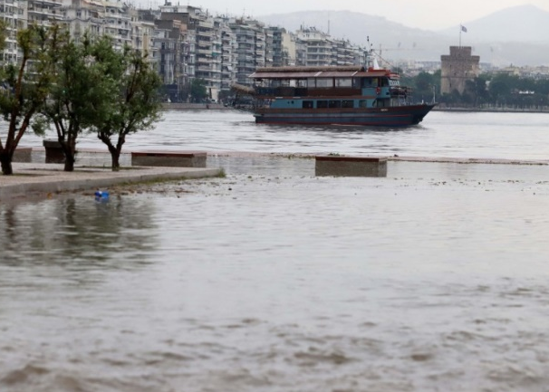
Introduction
«Flood»: The rising of a body of water and its overflowing onto normally dry land (Princeton University, 2005)
Impacts of flooding:
Social, Economic and Environmental (human life losses, property damages, environmental degradation)
CLIMATE CHANGE
Development of an Integrated Flood Protection Management Plan

Slide 3
Flood Risk Management
Risk Analysis
Strategies Development for Risk Reduction
Policies for Strategies Implementation
Integrated Flood Risk Management
River basin level approach
Interdisci-plinarity
Vulnera-bility and Risk Reduction
Addressing the Impacts of Climate Change
Stake-holders Involve-ment
(World Meteorological Organization, 2009)

Slide 4

Urban and Rural Flood Resilience
Maintain flood risk of an area at acceptable levels by:
Minimising damage and economic losses during flood event
Protecting the economic vitality of the area
Ensuring the social equity
Recovering quickly after the flood event

Slide 5
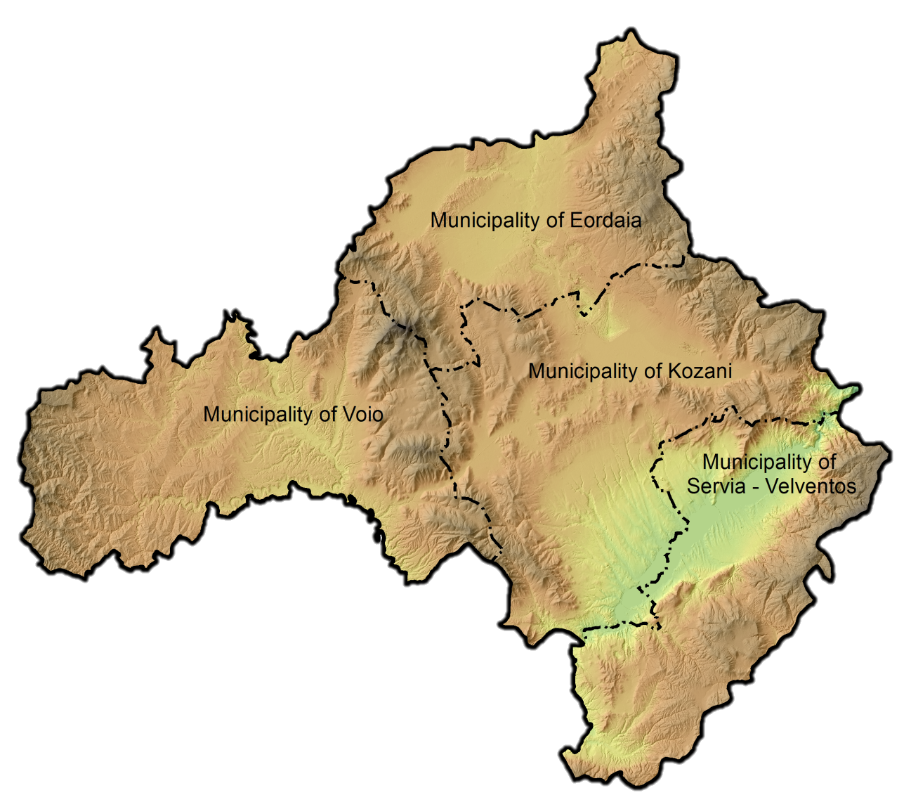
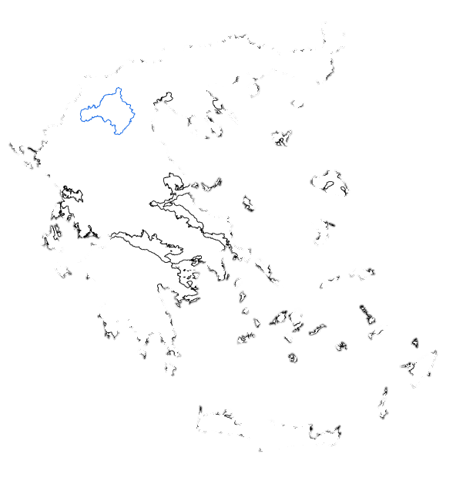
Master Plan for Flood Protection at Streams in the Regional Unit of Kozani
Population= 150,196 residents (census of year 2011)
Area= 3,516.79 km²

Slide 6
Master Plan for Flood Protection at Streams in the Regional Unit of Kozani
Main phases of the Master Plan:
Collection of the relevant studies and recording of the problems and complaints
Collection of the relevant data included in the 1st Revision of the River Basin Management Plan and the Flood Risk Management Plan and digitization of the surface water bodies
Performing site inspection at all locations where problems or/and complaints have been reported
Evaluation of the current situation in order the common cases to be grouped
Development of a data recording list and a Geographic Information System (G.I.S.) database including all the necessary spatial information

Slide 7
Master Plan for Flood Protection at Streams in the Regional Unit of Kozani
Main phases of the Master Plan:
Development of holistic thematic maps regarding lakes, rivers, technical works, settlements and other characteristics of the study area
Categorization of the necessary interventions: (a) short-term (removal of vegetation, litter and sediment as well as small-scale technical works) and (b) long-term (large-scale technical works) interventions
Drawing up of tender documents for the short-term proposed actions
Determination of assessment criteria and ranking of the proposed long-term actions

Slide 8
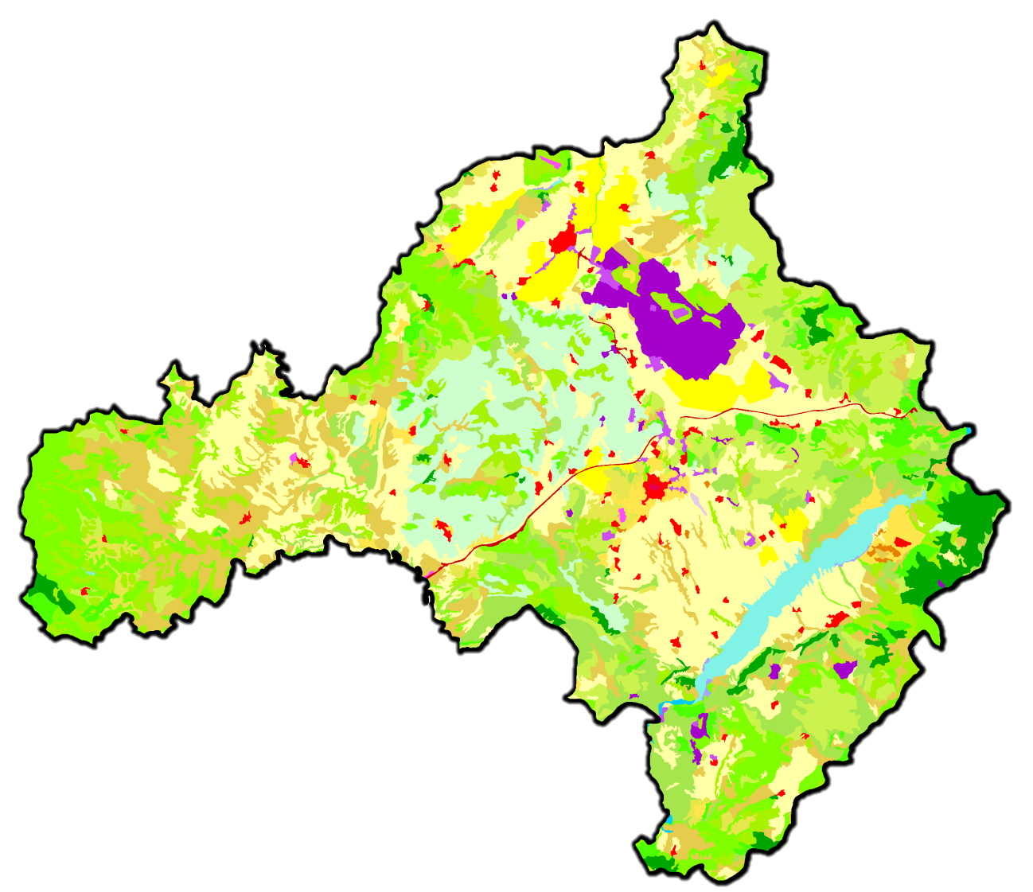
Land Cover of the Regional Unit of Kozani
Corine Land Cover 2018:
Artificial surfaces
(173.02km²) (4.92%)
Agricultural areas
(1,378.62km²) (39.20%)
Forest and semi natural areas
(1,895.06km²) (53.89%)
Wetlands
(2.01km²) (0.06%)
Water bodies
(68.07km²) (1.94%)

Slide 9
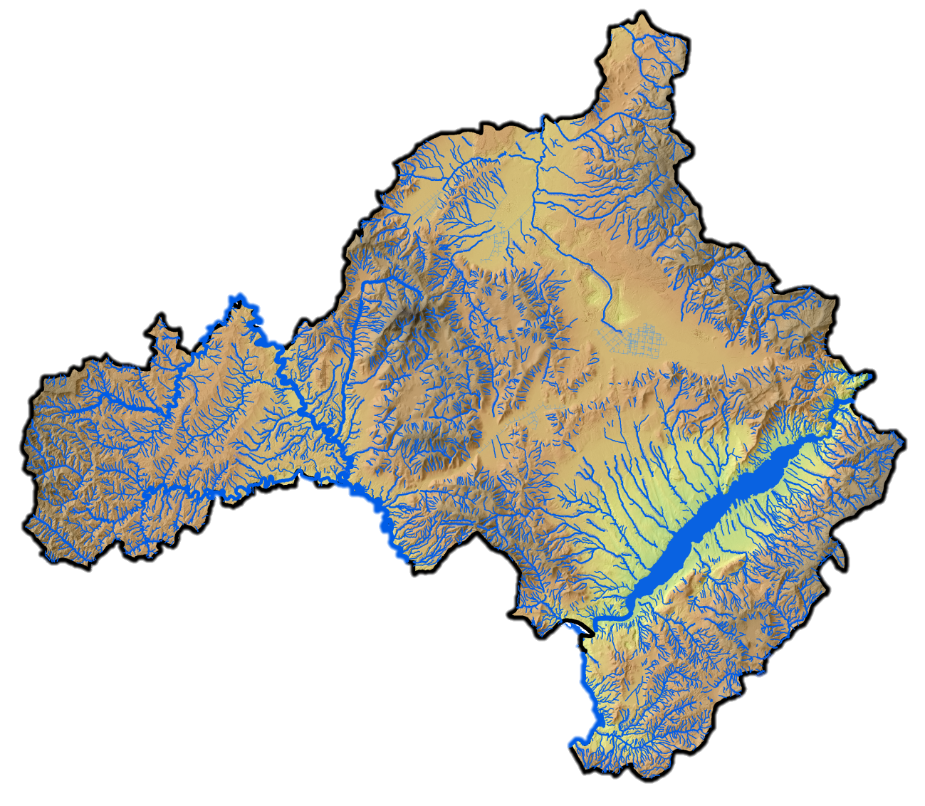
Surface Water Bodies in the Regional Unit of Kozani
1st Revision of the River Basin Management Plan of Western Macedonia:
28 rivers
4 lakes

Slide 10
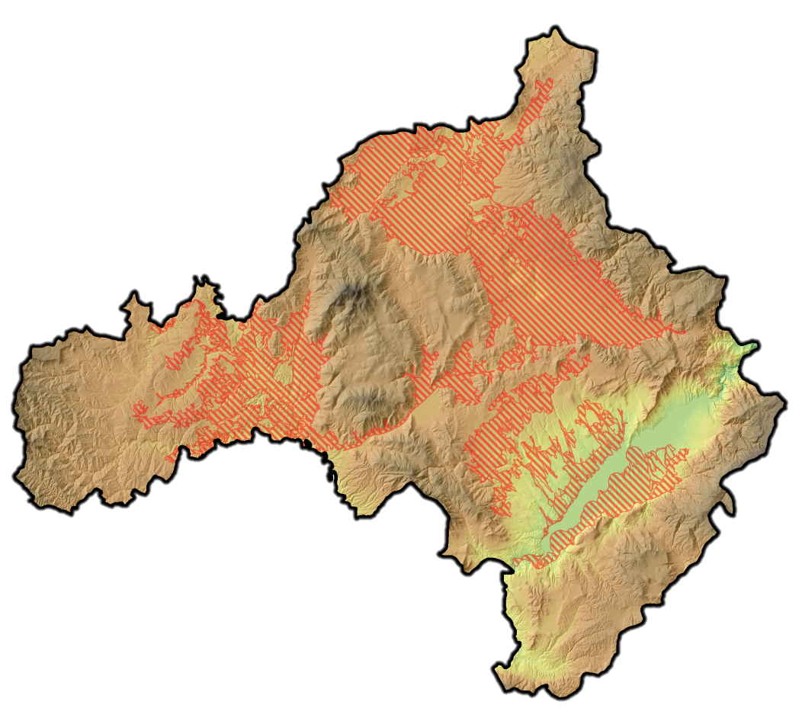
Areas of Potential Significant Flood Risk
Areas of Potential Significant Flood Risk (APSFR, Article 5 of Floods Directive): Areas for which potential significant flood risks exist or might be considered likely to occur
APSFR in the study area:
EL09RAK0003
EL09RAK0004
EL09RAK0005
EL09RAK0006
EL09RAK0007
EL09RAK0008
Total area: 868.88km²
(24.71% of the Master Plan area)

Slide 11
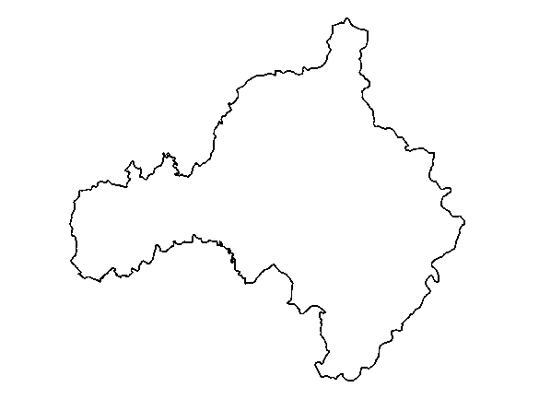
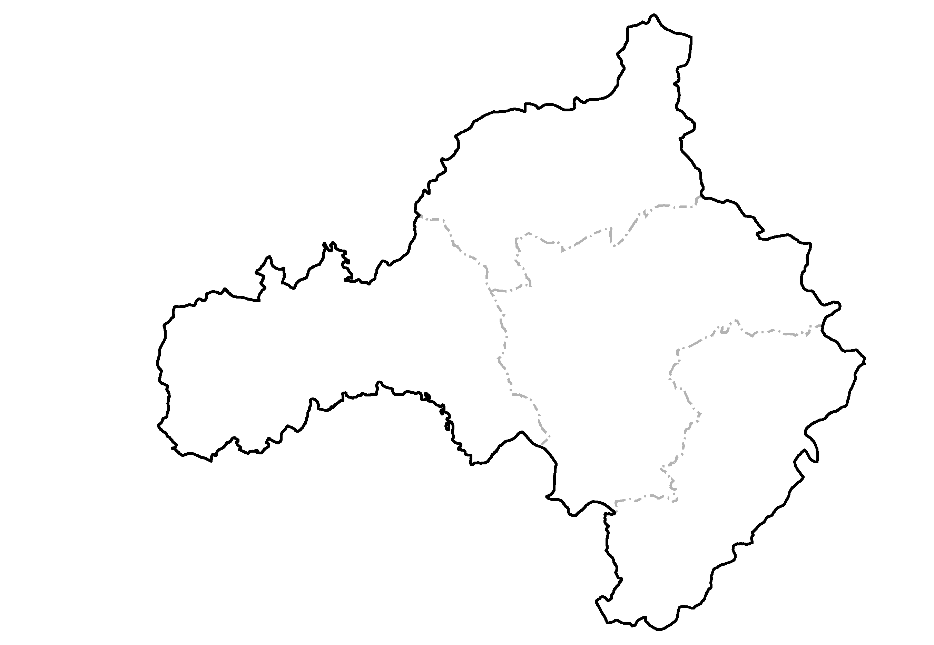
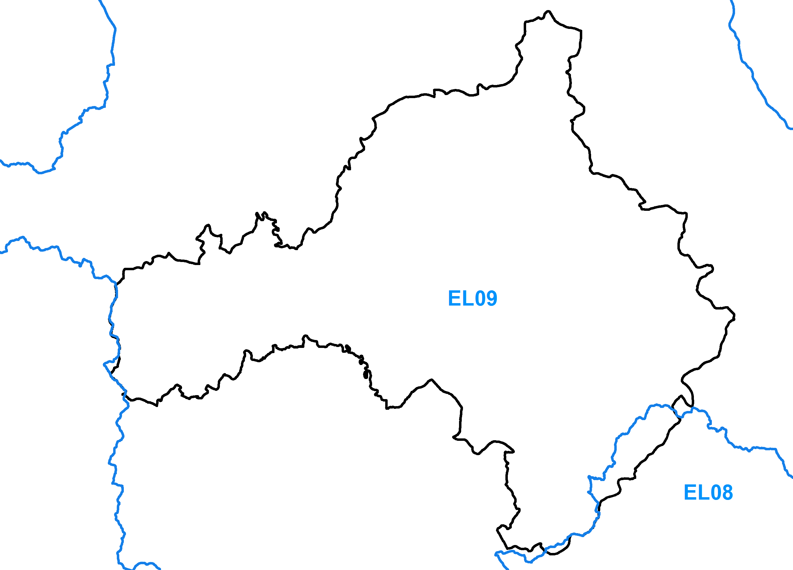
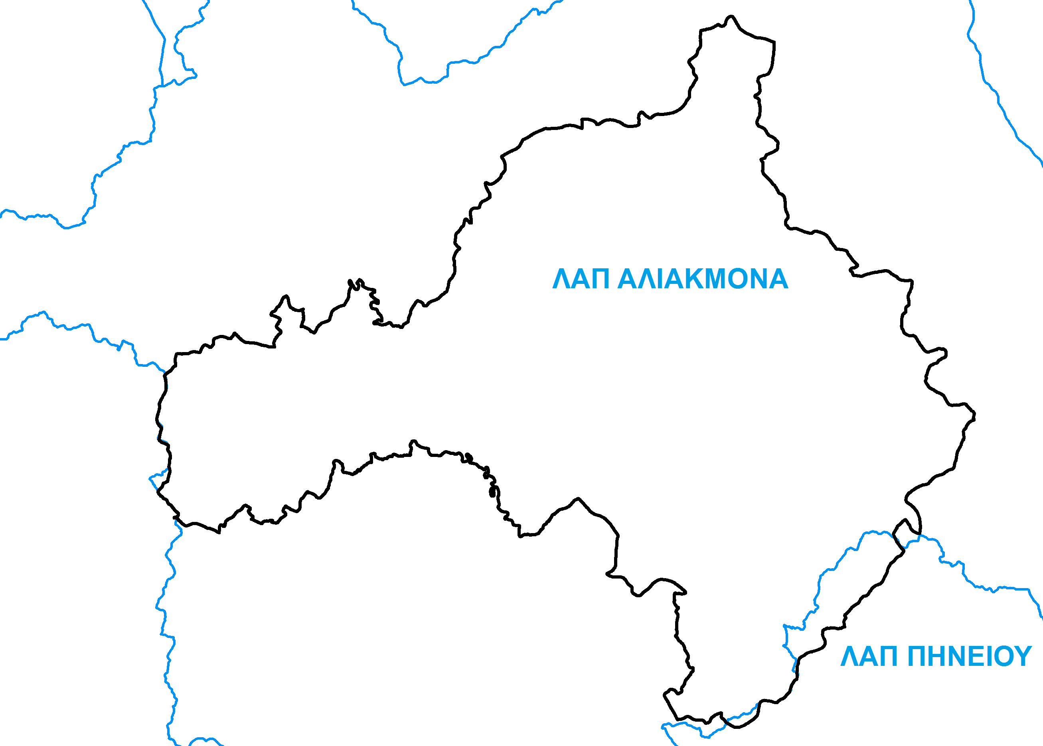
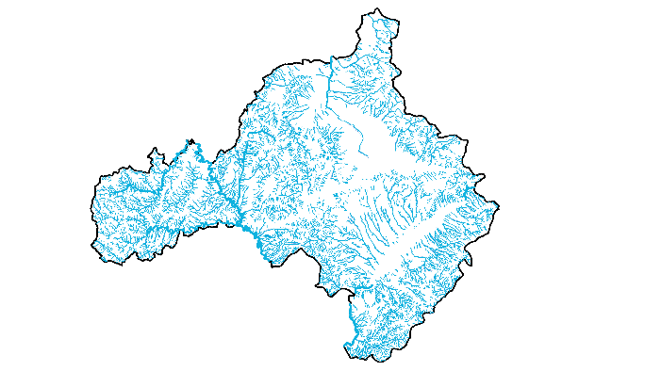
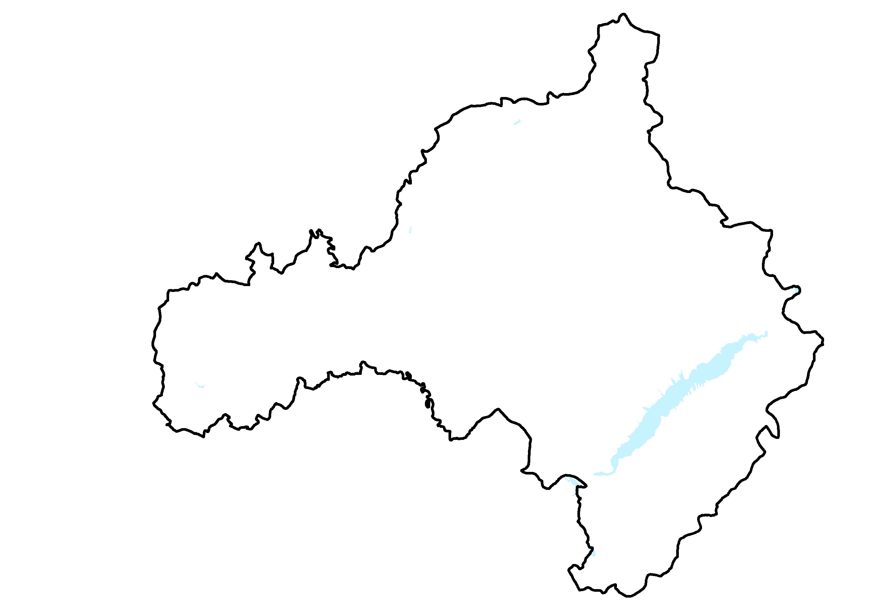
Development of a GeoDatabase
Regional Unit boundary
Municipalities
Water District boundaries
Water basin boundaries
Streams
Lakes

Slide 12
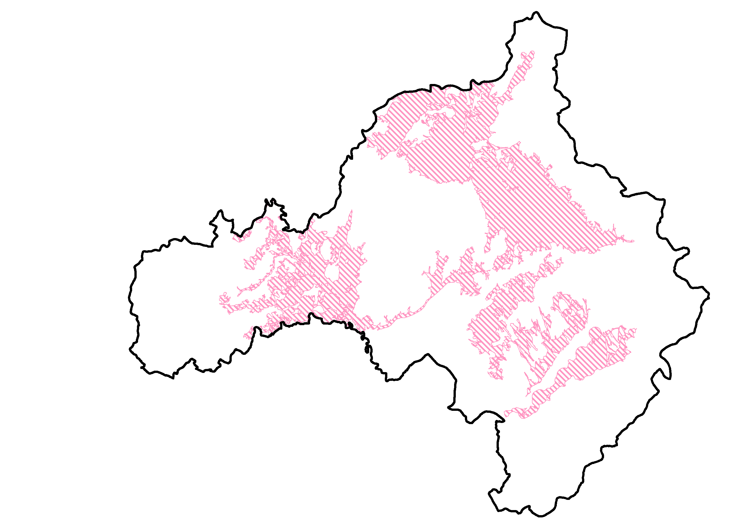
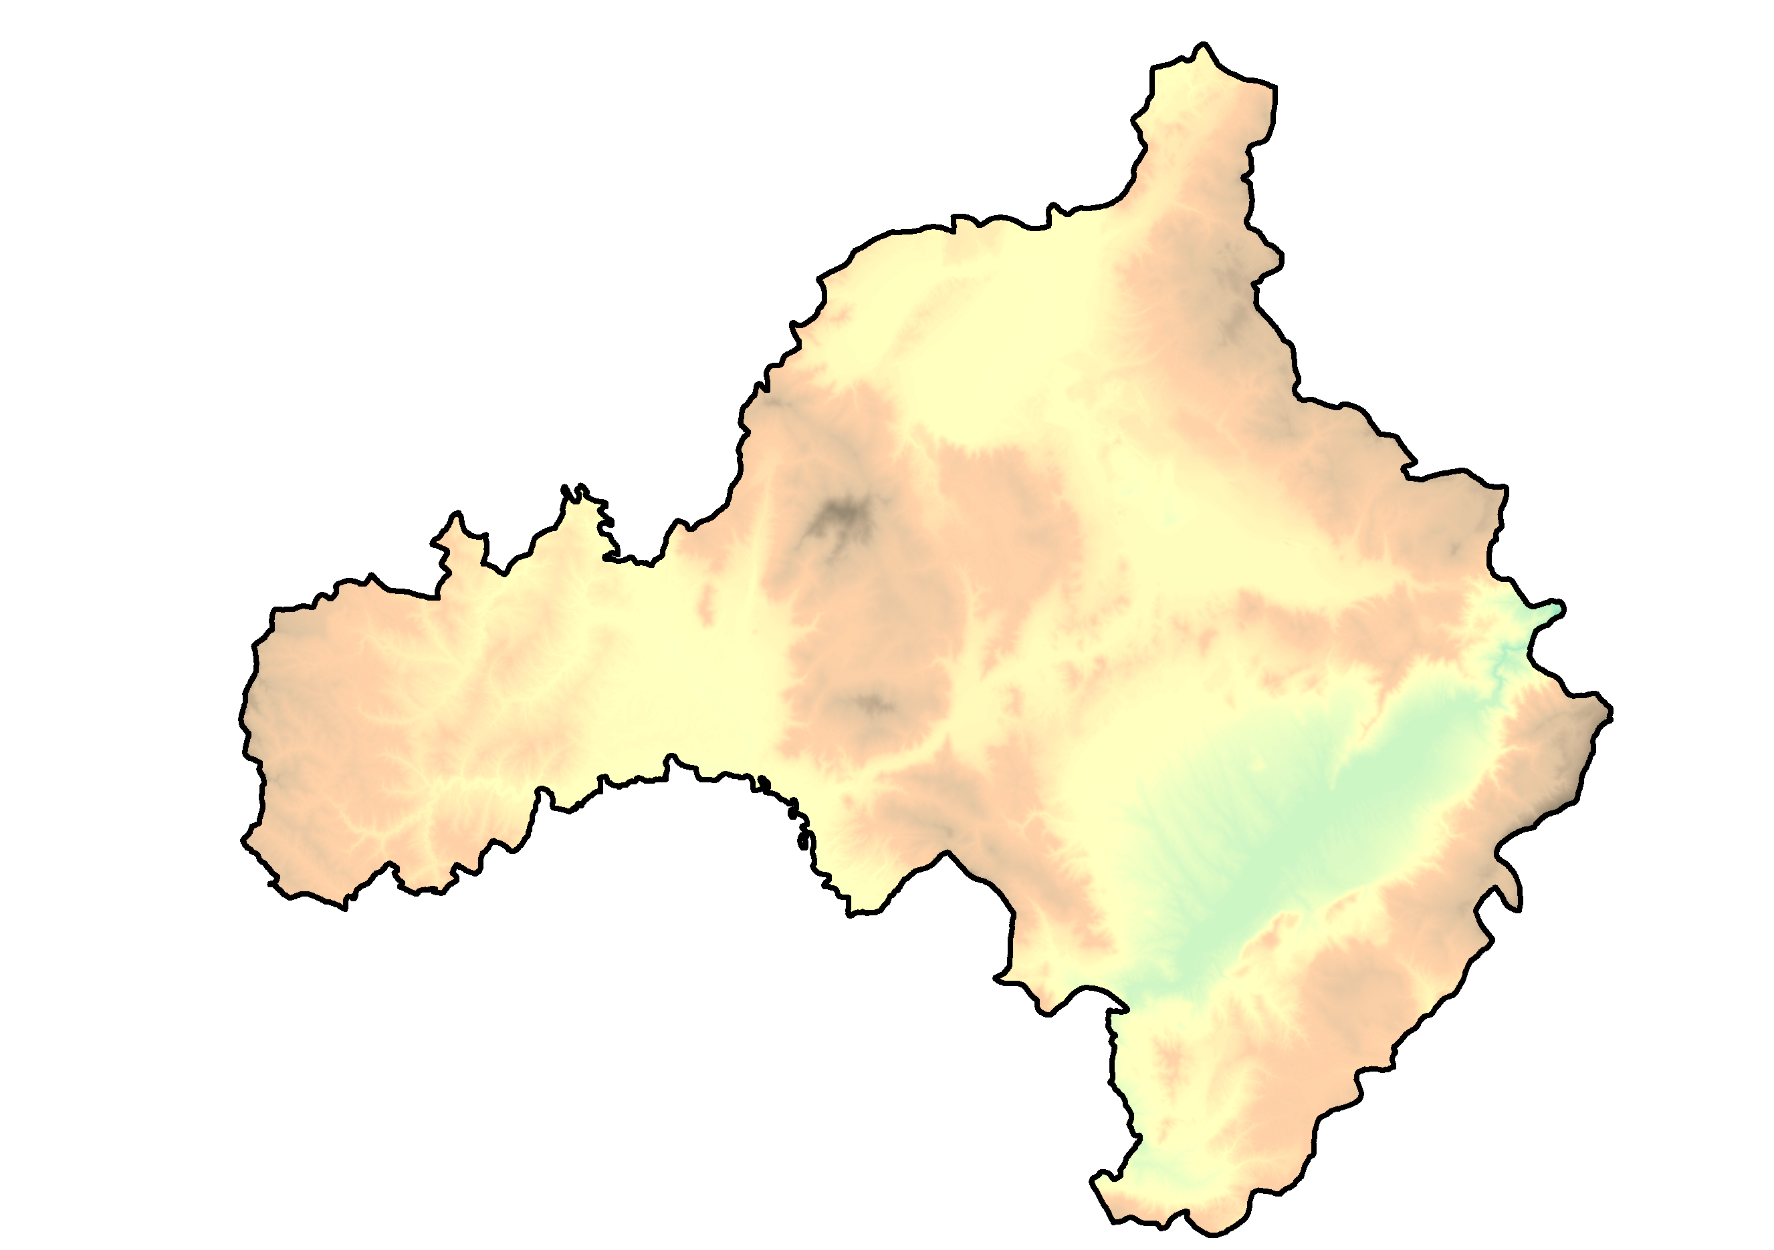
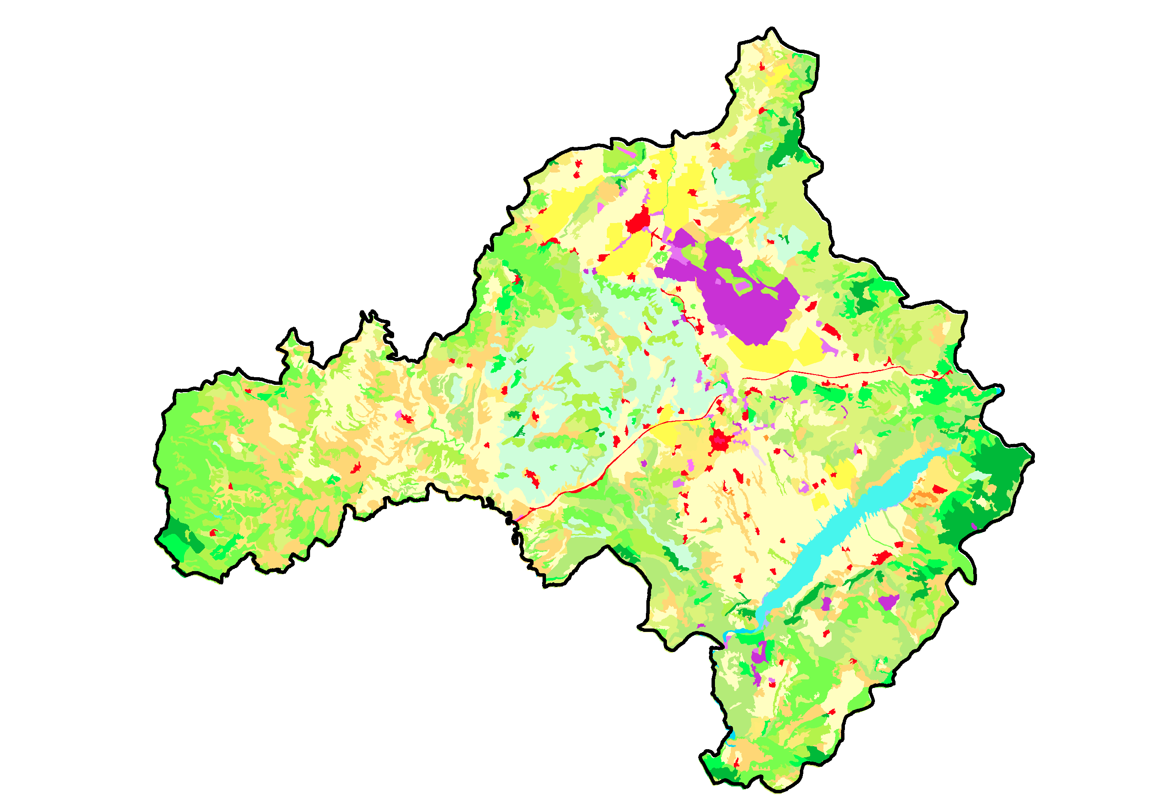
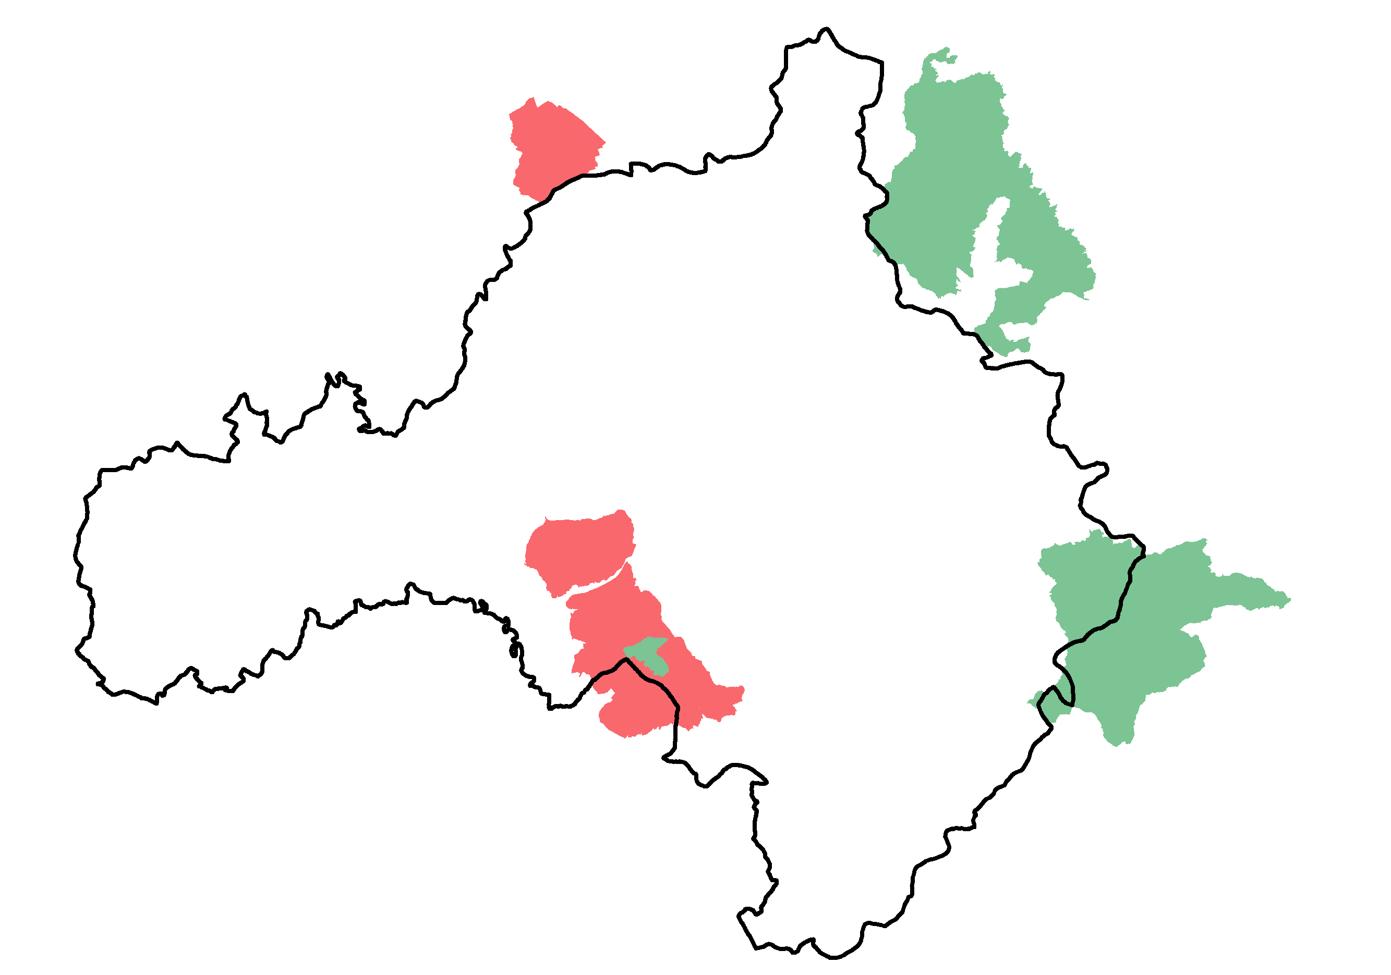
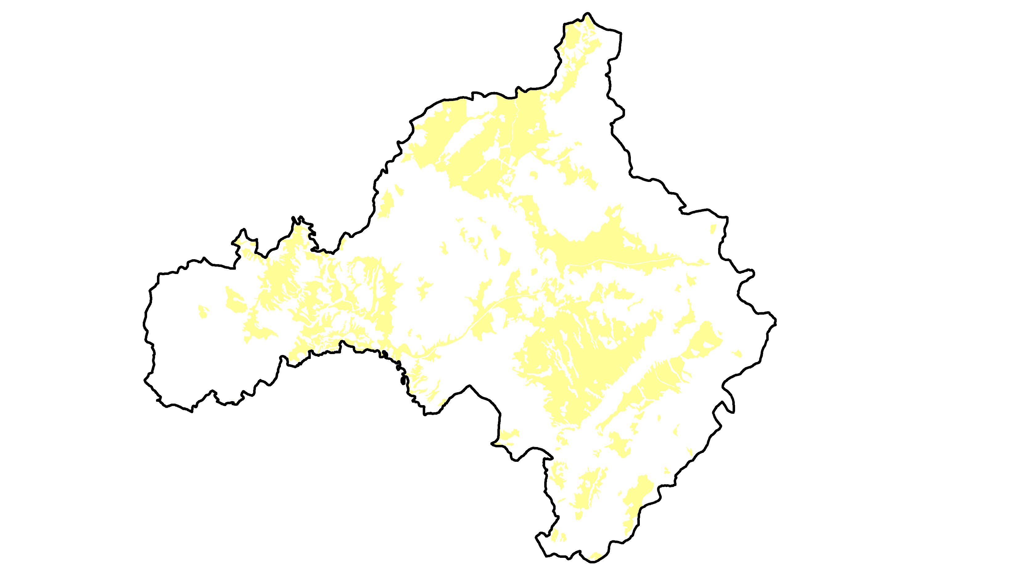
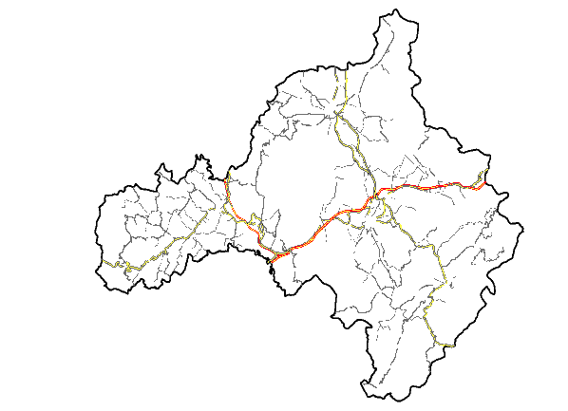
Development of a GeoDatabase
Areas of Potential Significant Flood Risk
Digital Elevation Model
Corine Land Cover
Natura 2000 area
Cultivated area
Road network

Slide 13
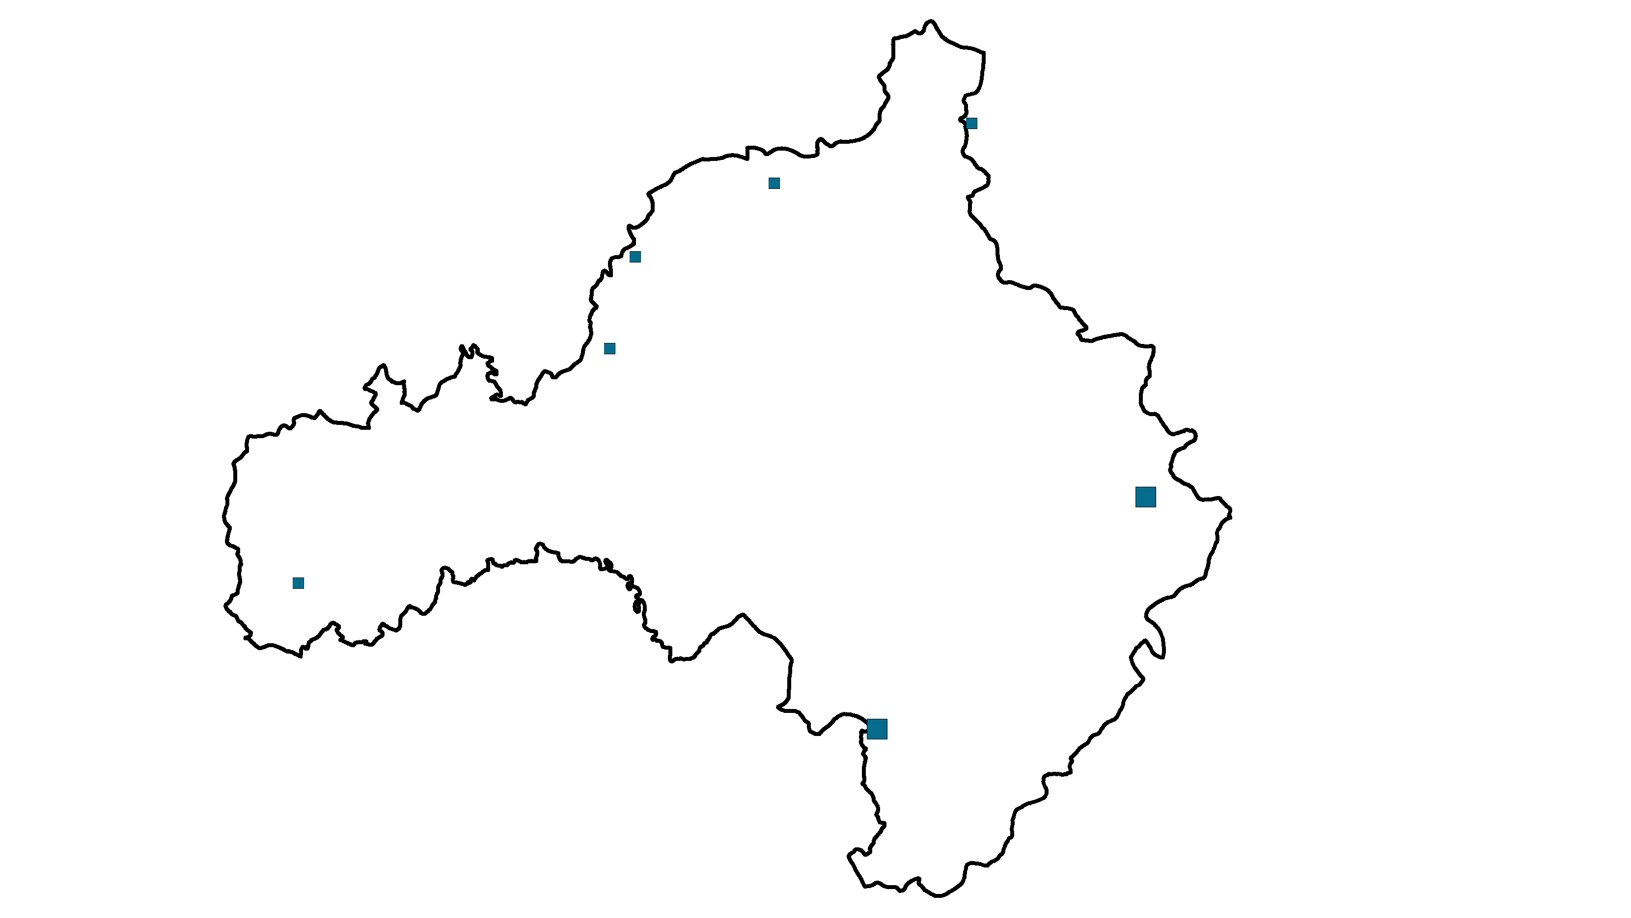
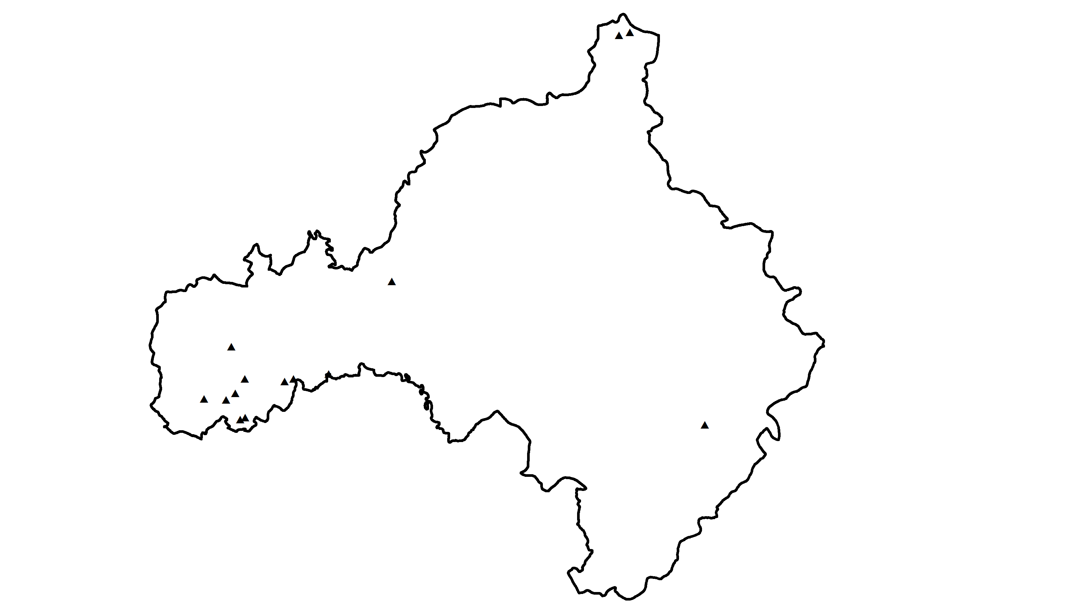
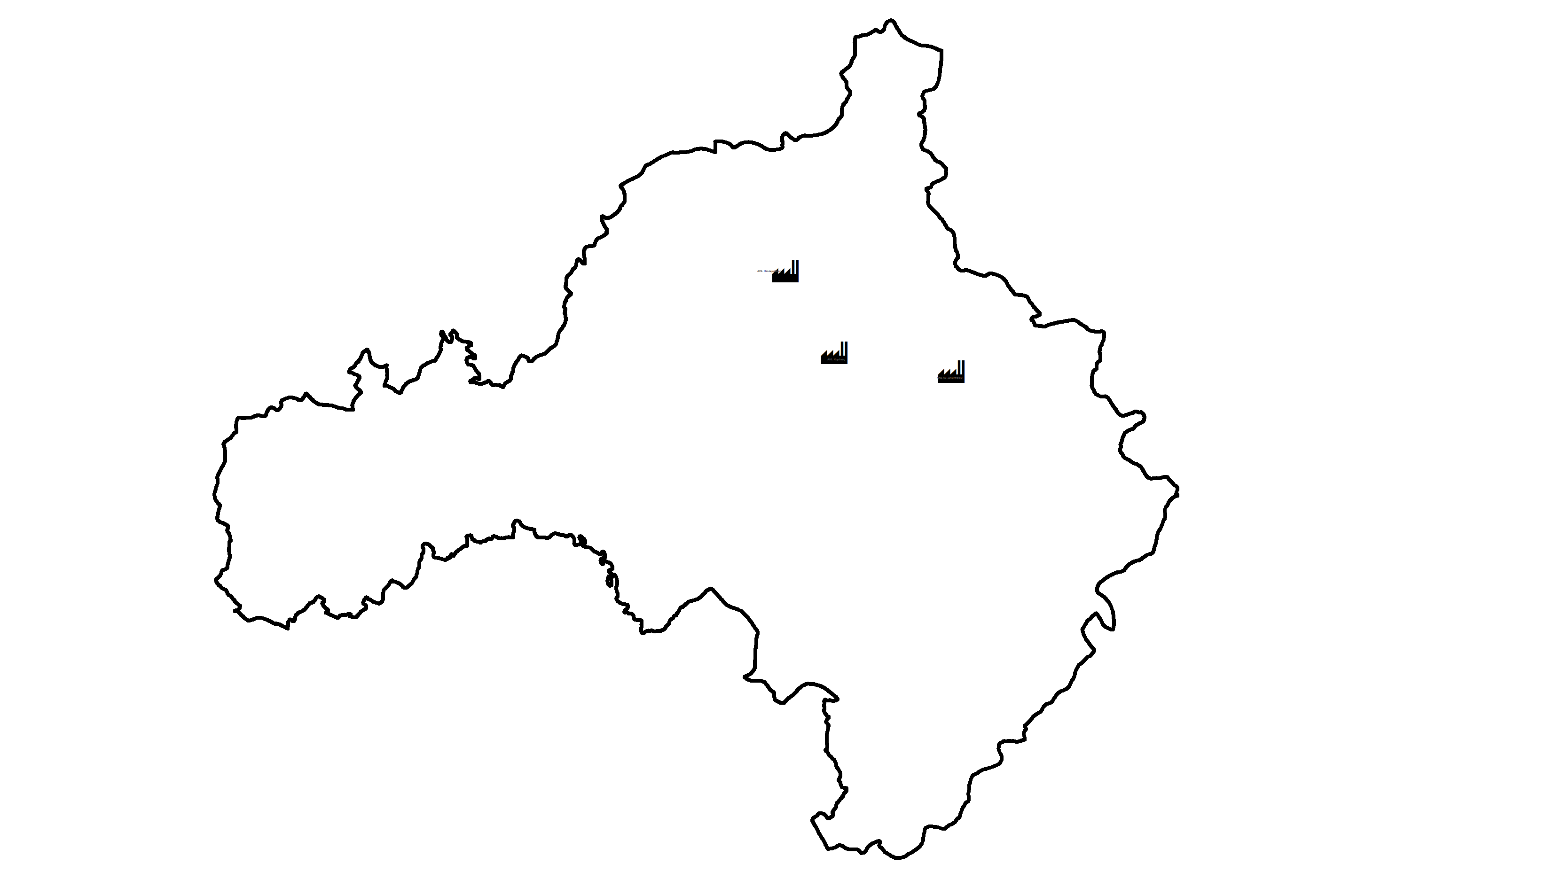
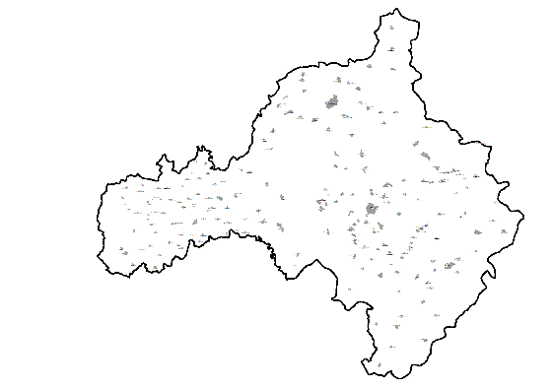
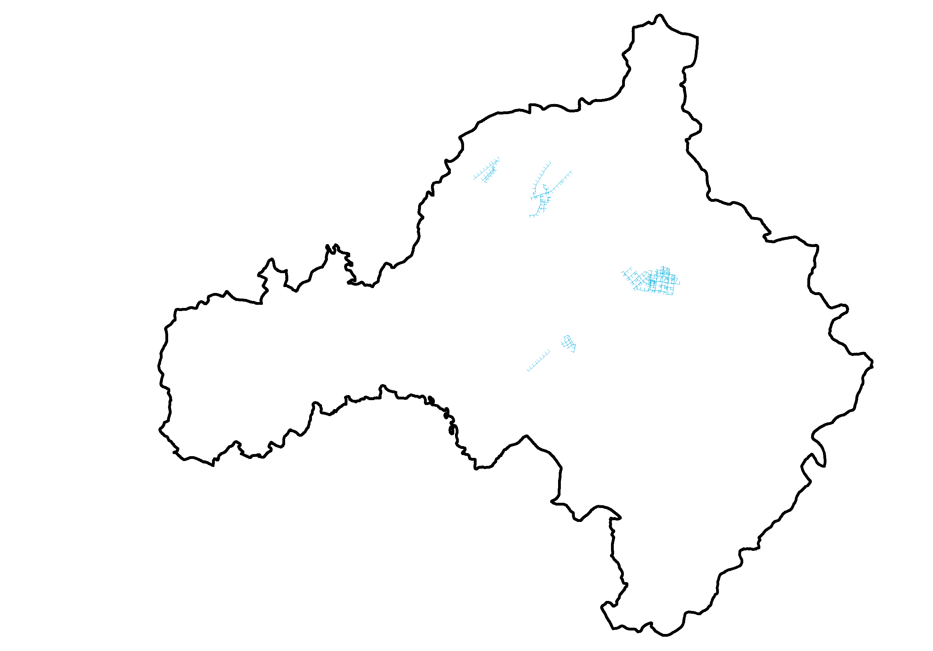
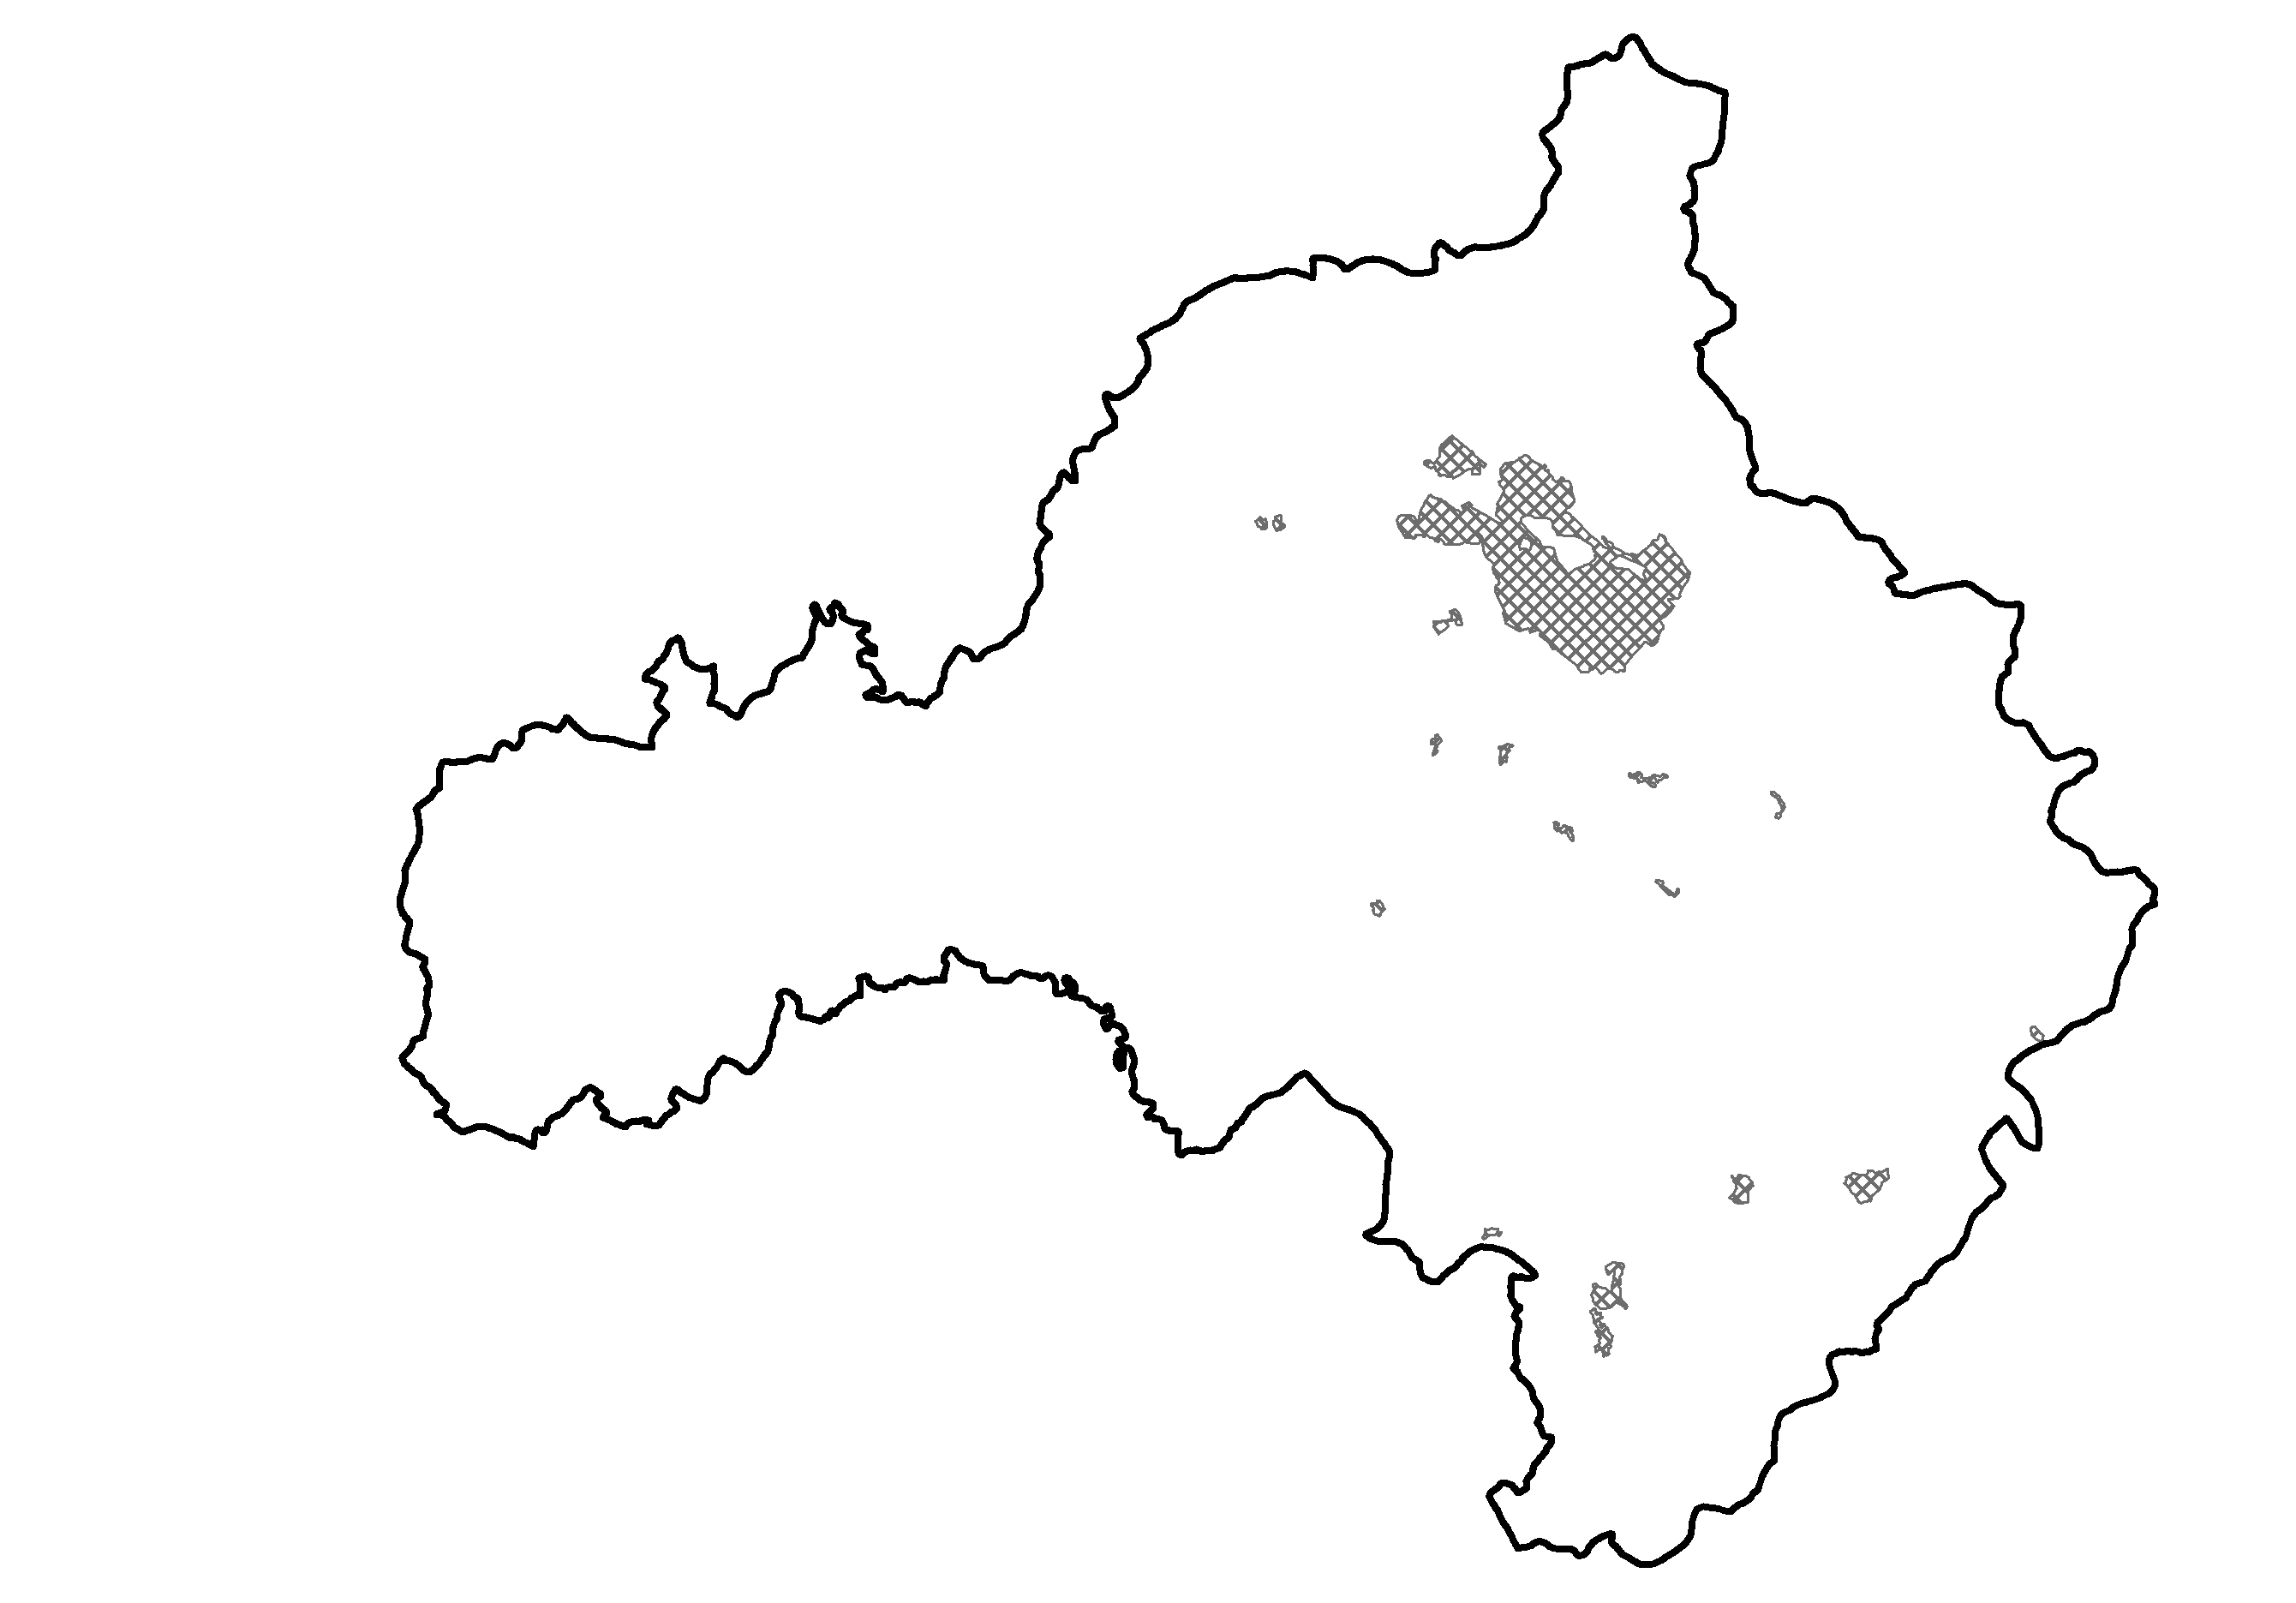
Development of a GeoDatabase
Dams
Stone bridges
Thermal power stations
Settlemenets
Irrigation canals
Mines

Slide 14
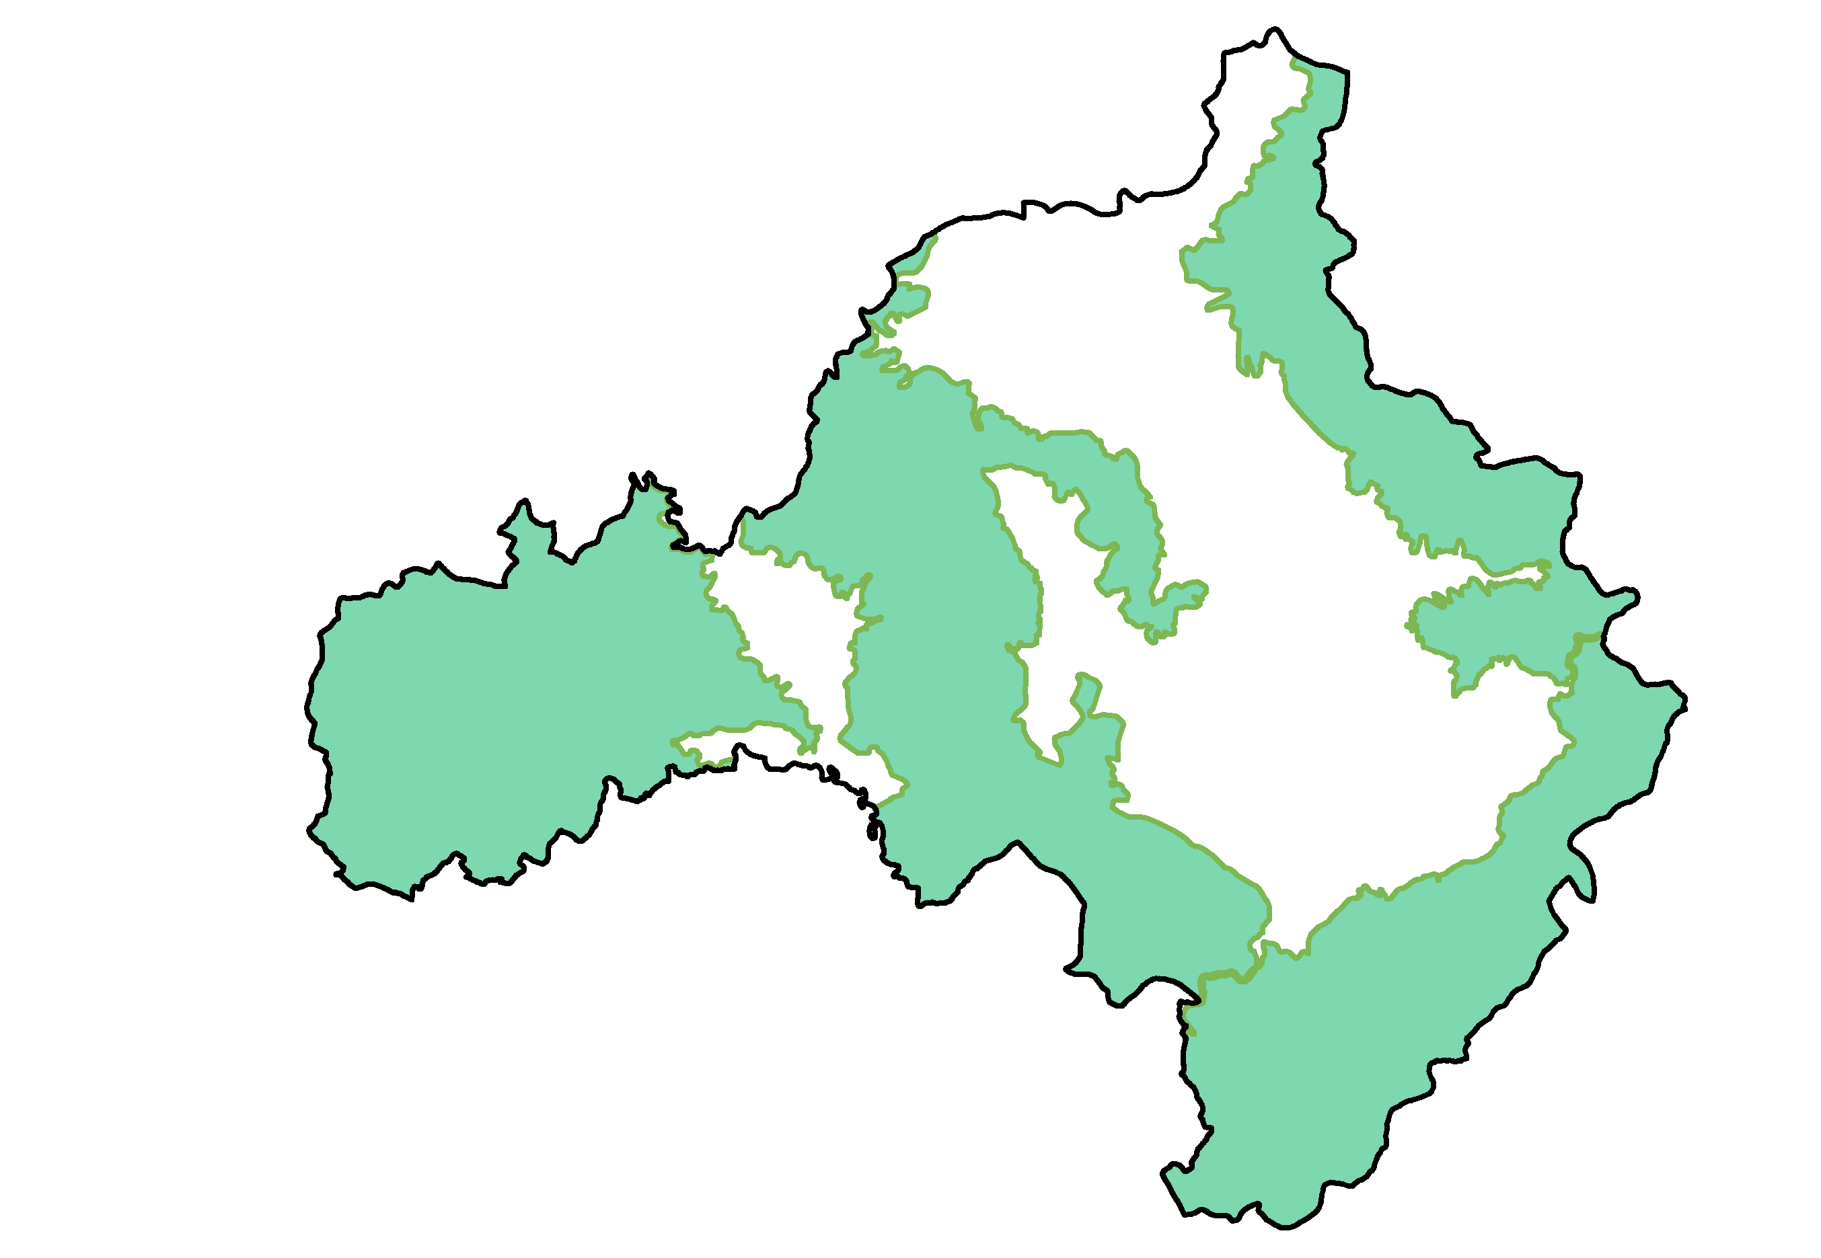
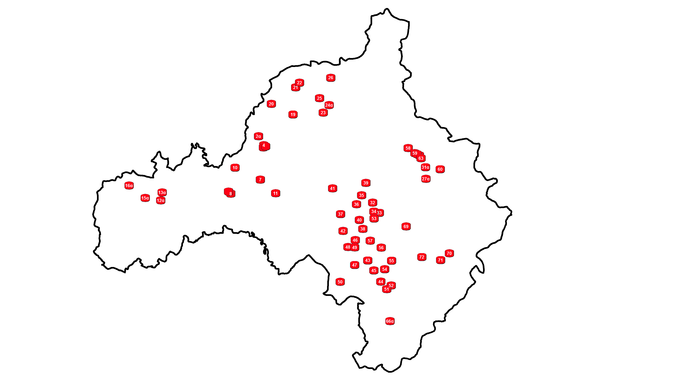
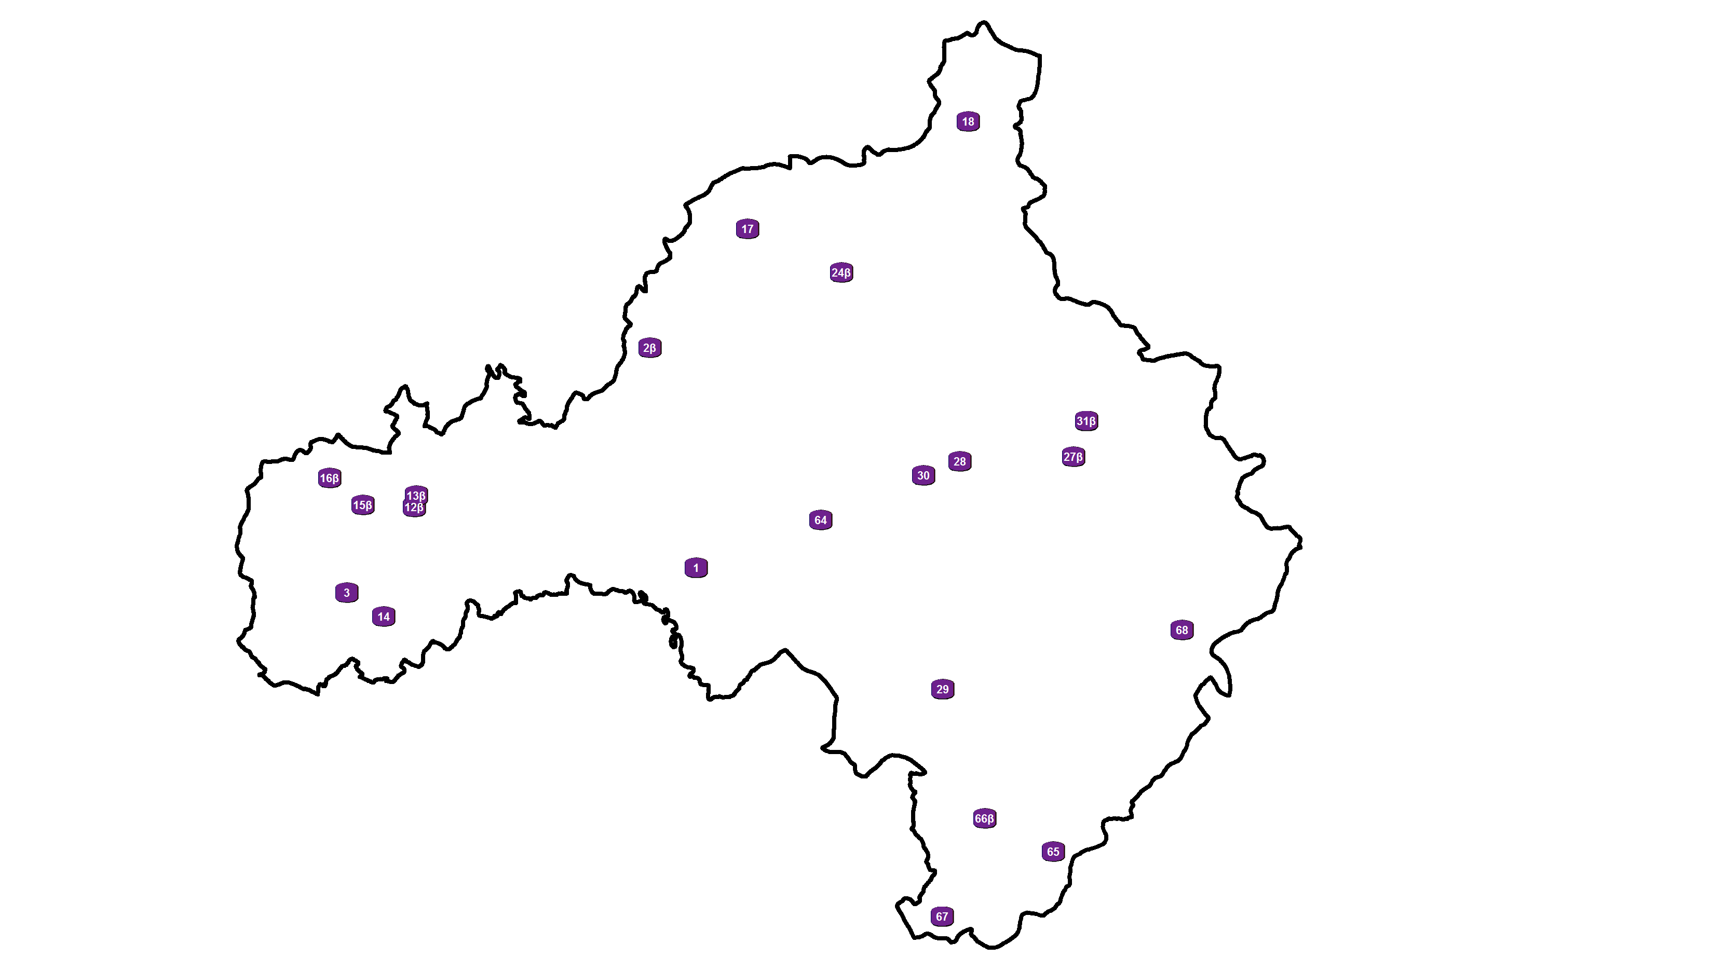
Development of a GeoDatabase
Mountainous and lowland area
Location of short-term interventions
Location of long-term interventions

Slide 15
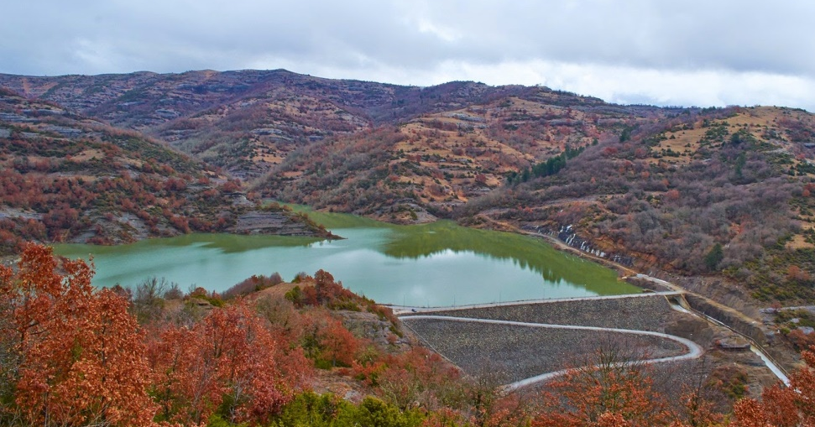
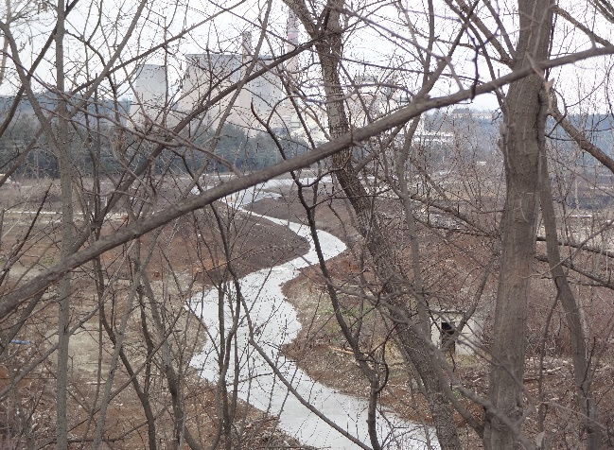
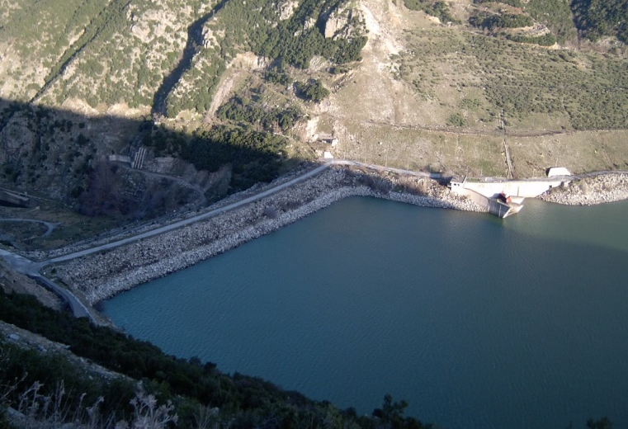
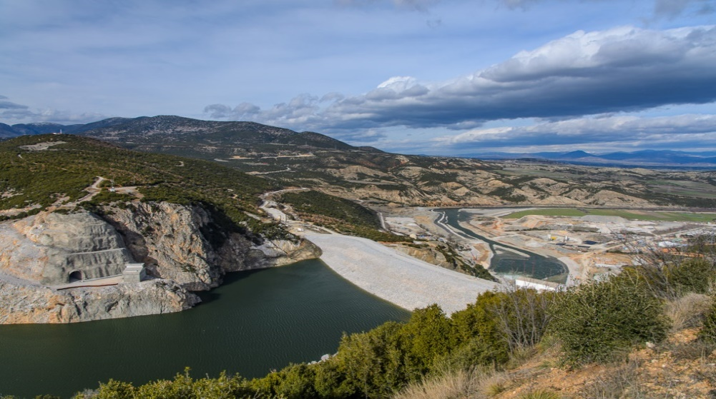
Major Hydraulic Projects
Dam of Pramoritsa
Soulou artificial river
Polyfytos artificial Lake
Ilarionas artificial Lake

Slide 16
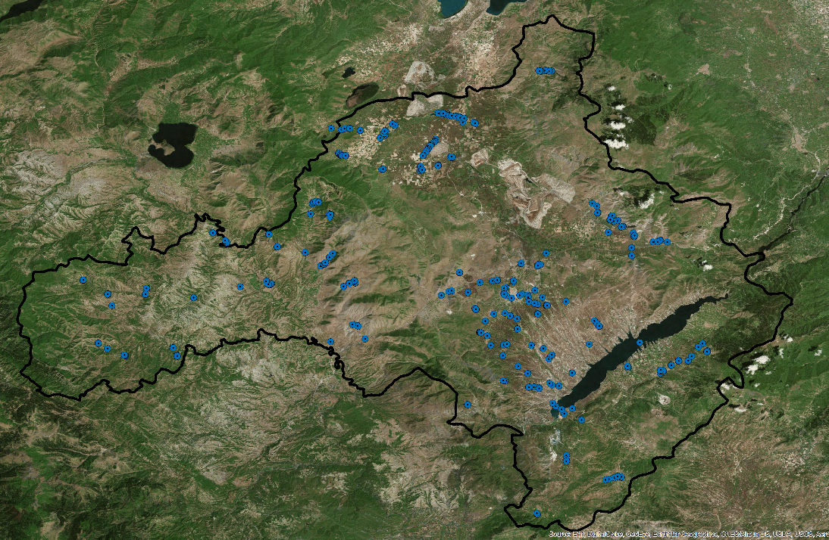
Site inspections
Site inspections were performed in May 2019 at all locations where problems or/and complaints have been reported
Location of 1,645 photos

Slide 17
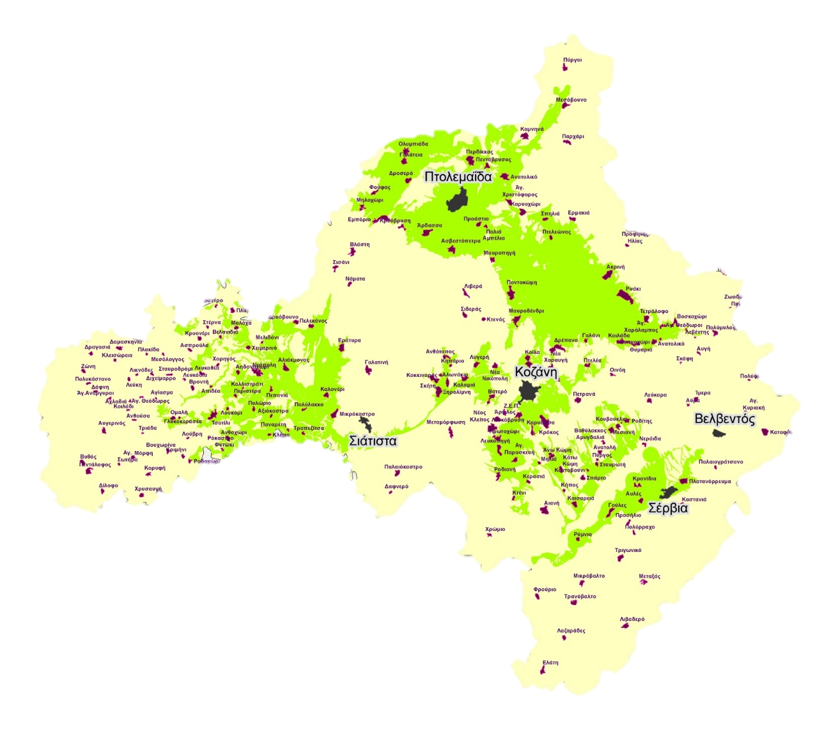

Determination of Assessment Criteria
Areas of Potential Significant Flood Risk (APSFR)
Areas for which potential significant flood risks exist or might be considered likely to occur
APSFR

Slide 18
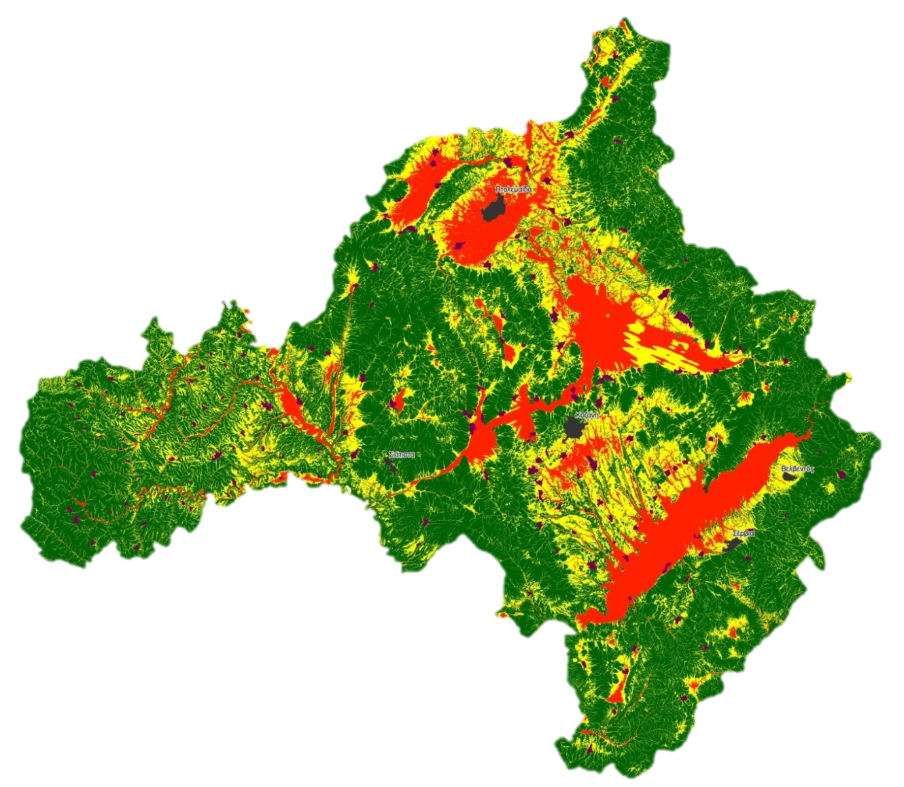

Determination of Assessment Criteria
Topographic Wetness Index (TWI)
Describes the impact of surface on the soil moisture distribution
low values
average values
high values

Slide 19
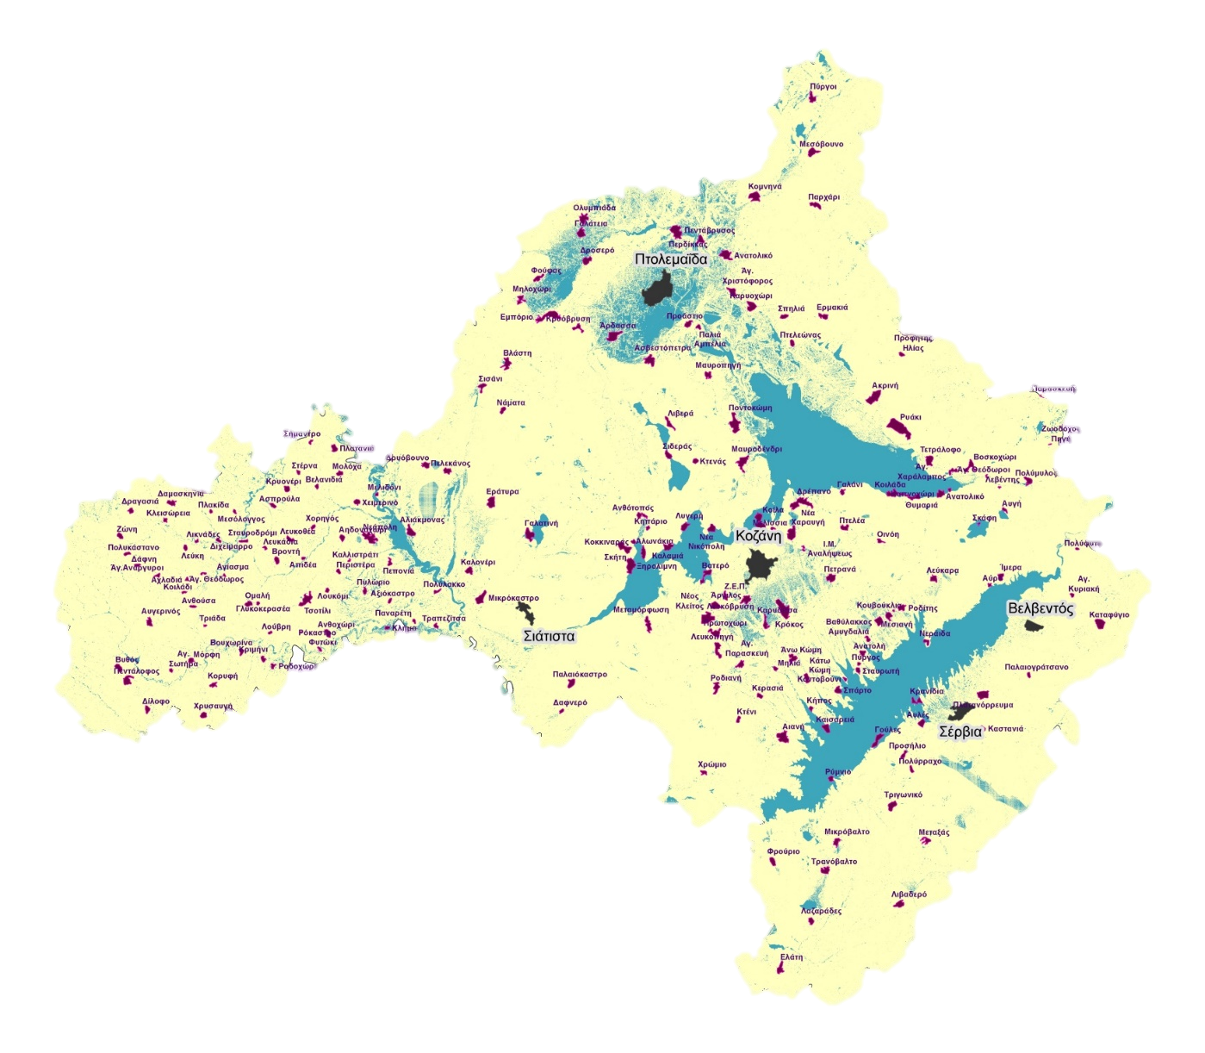
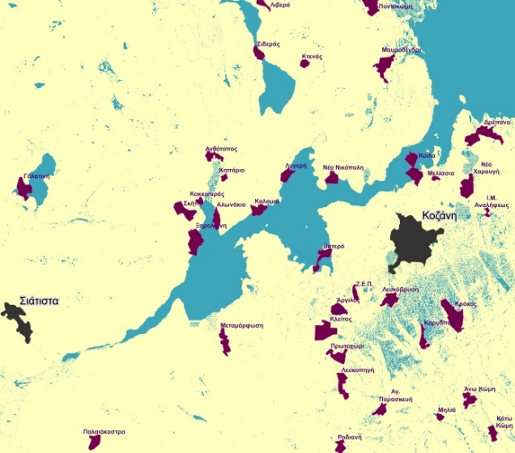
Determination of Assessment Criteria
Low slope criterion
Slope< 2%
Slope≥ 2%

Slide 20
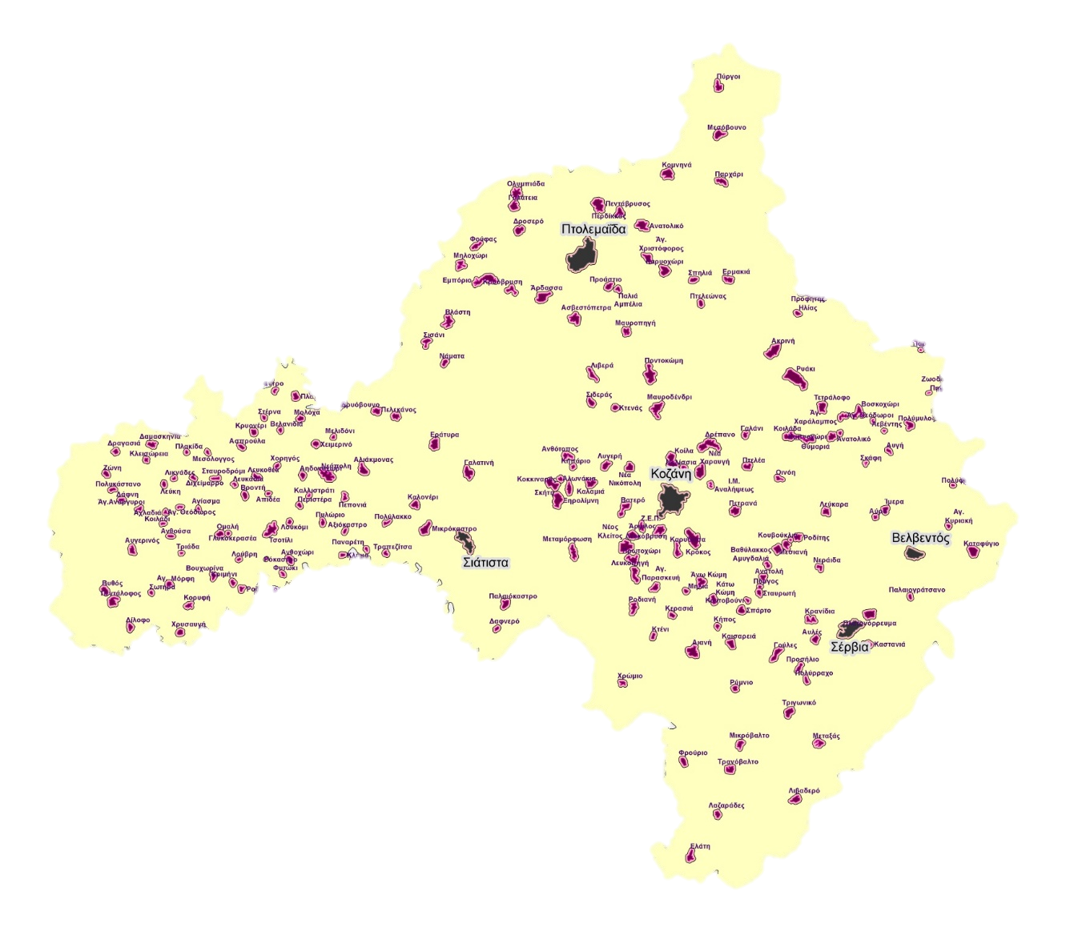

Determination of Assessment Criteria
Distance from settlements criterion
200m buffer area around settlements

Slide 21
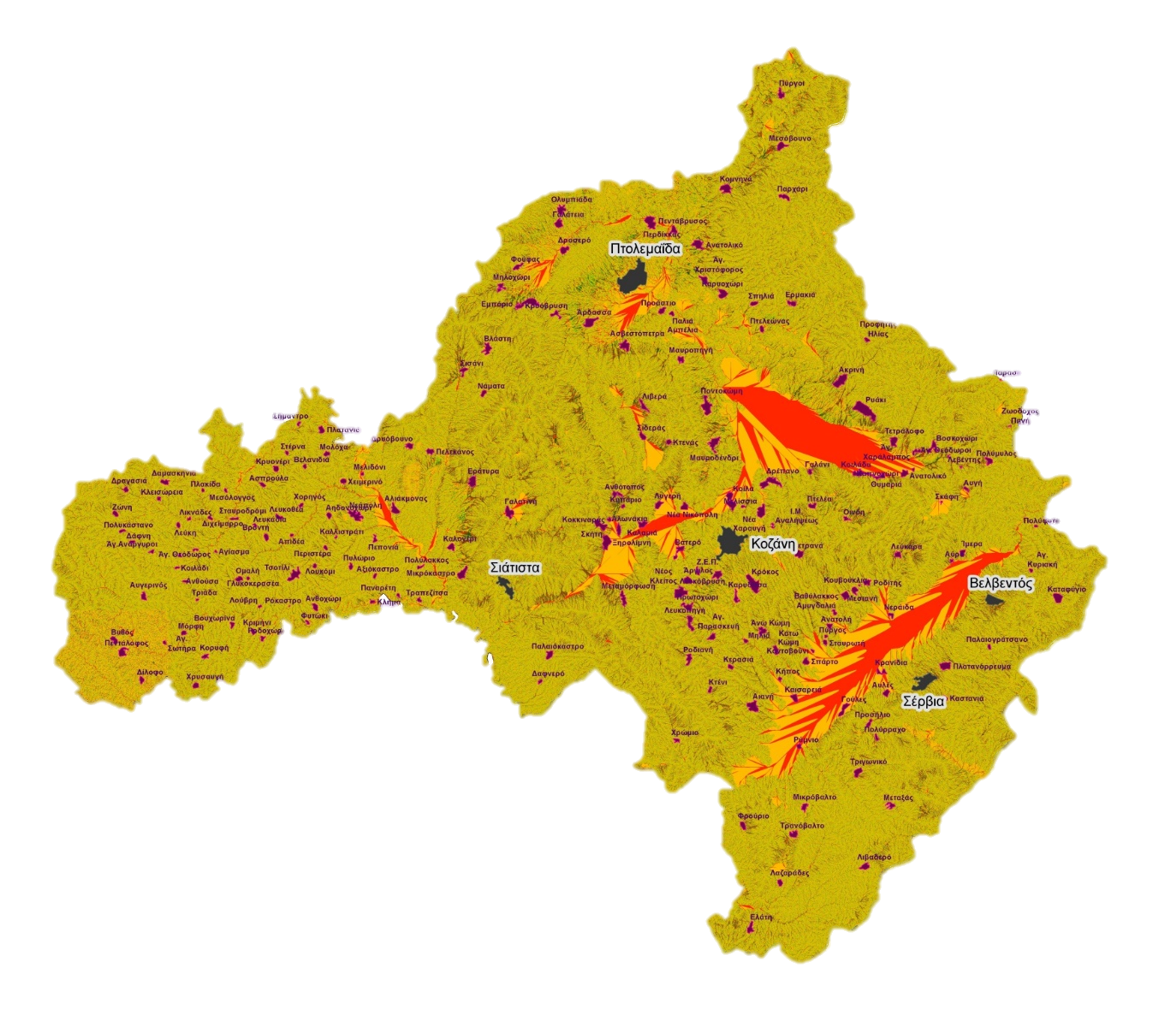

Determination of Assessment Criteria
Stream Power Index (SPI)
Measures the erosion level of a river
zero value
low values
average values
high values

Slide 22
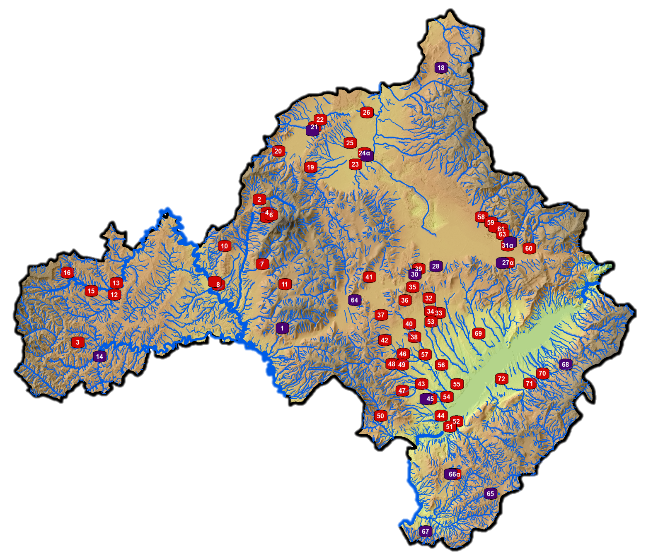


Short-term and Long-term Interventions
Necessary interventions:
short-term
long-term

Slide 23
Update of the Master Plan for Flood Protection Works in areas of the Prefecture of Thessaloniki
Call (May 2018)
Update of the Master Plan for Flood Protection Works in areas of the Prefecture of Thessaloniki
Directorate of Flood Protection Works and Irrigation Works (D19)

Slide 24
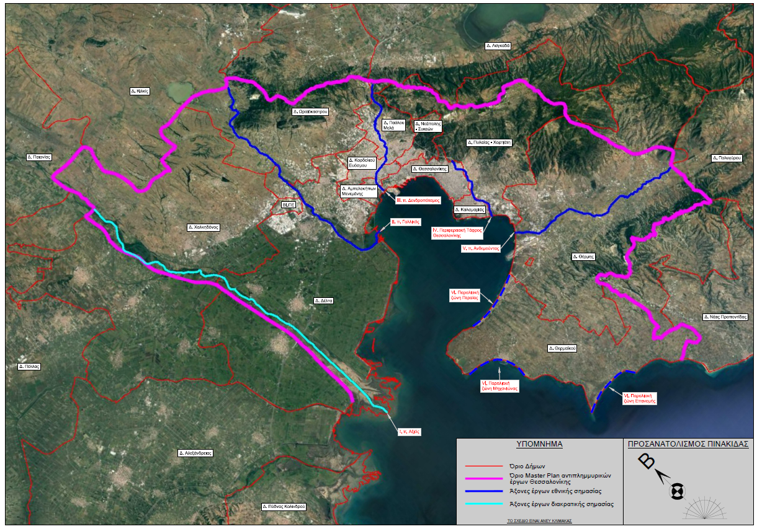
Spatial Planning Framework
Dr. Spyridis Anthimos, Vafeiadis Margaritis, Diamanti Lena, Elpekos Stelios, Theodossiou Nikolaos, Dr. Iossifidis Vasileios, Iossifidis Filippos, Kechagias Eleftherios, Limnaios Stavros, Mallios Zisis, Peilidis Georgios, Samaras Gregory, Vogiatzis Pantelis, Zikopoulou Olia, Soultanis Konstantinos, Stamataki Styliani
Working Group of Technical Chamber of Greece
The area of the Master Plan was determined
Municipalities
Master Plan
area boundaries
Main line of
national importance projects
Main line of
international importance projects

Slide 25
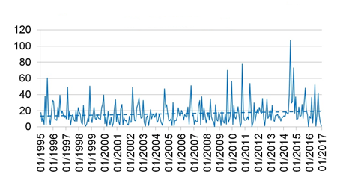
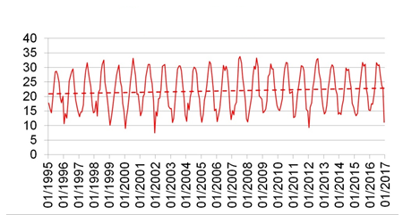
Climate variability in Thessaloniki
Maximum daily rainfall per month
Extreme rainfall events will be intensified in the eastern Mediterranean area (IPCC, 2013)
Average temperature will be increased in the eastern Mediterranean area (IPCC, 2013)
Maximum daily temperature per month
Frequency and magnitude of flood events will be intensified (IPCC, 2012)
* IPCC (Intergovernmental Panel on Climate Change)

Slide 26
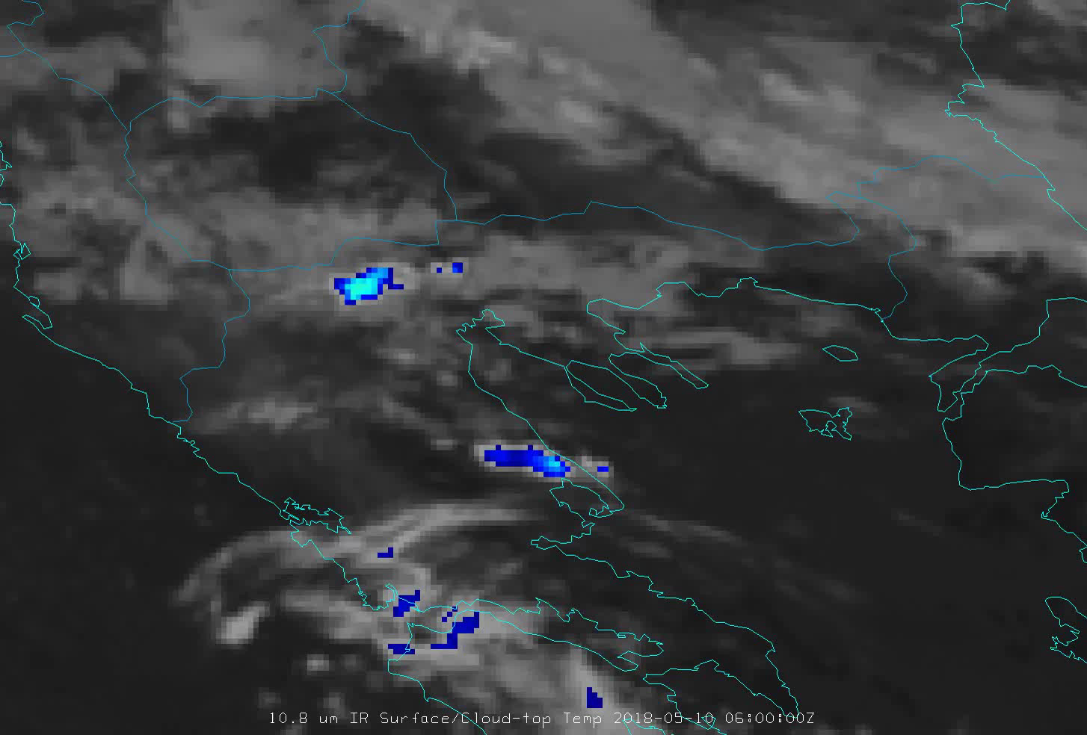
Extreme rainfall events in Thessaloniki
Thessaloniki, 10th May 2018, 09:00 - 21:00
(European Organisation for the Exploitation of Meteorological Satellites, 2019)
Thessaloniki city:
1931-1960: Average rainfall of May= 40,2mm/month
1961-1990: Average rainfall of May= 50,3mm/month
10th May 2018: Daily rainfall= 72,4mm/day

Slide 27
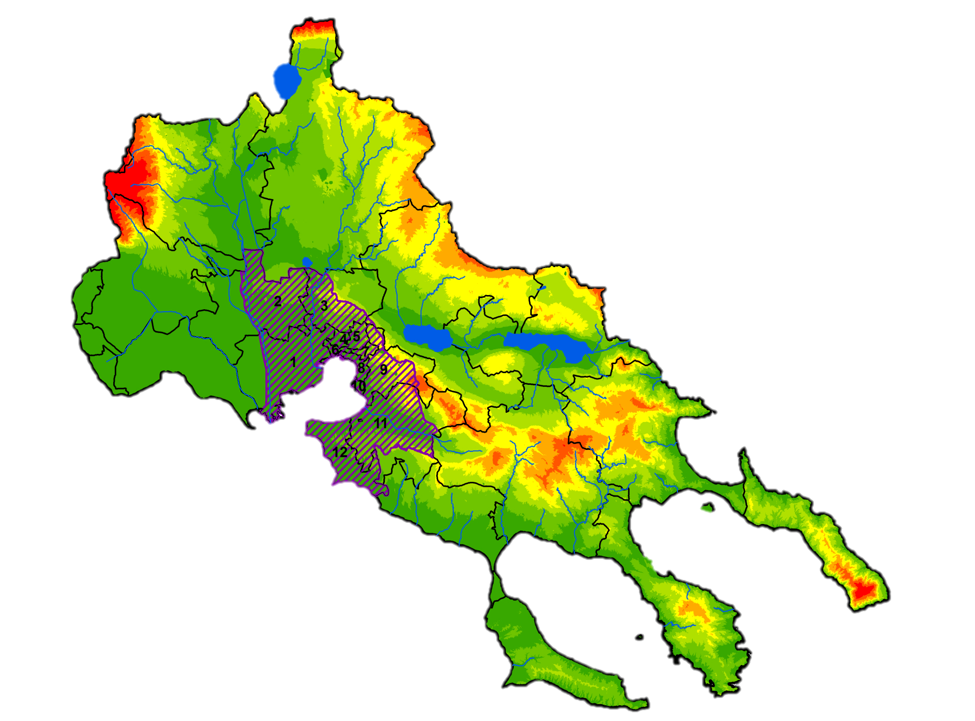
Update of the Master Plan for Flood Protection Works in areas of the Prefecture of Thessaloniki
Study area (1,104.02km²)
Municipalities:
1. M. of Delta (70.13%)
2. M. of Chalkidona (52.31%)
3. M. of Oraiokastro (55.06%)
4. M. of Kordelio - Evosmos (100%)
5. M. of Pavlos Melas (100%)
6. M. of Ampelokipoi - Menemeni (100%)
7. M. of Neapoli - Sykees (100%)
8. M. of Thessaloniki (100%)
9. M. of Pylaia - Chortiatis (65.52%)
10. M. of Kalamaria (100%)
11. M. of Thermi (61.99%)
12. M. of Thermaikos (100%)

Slide 28
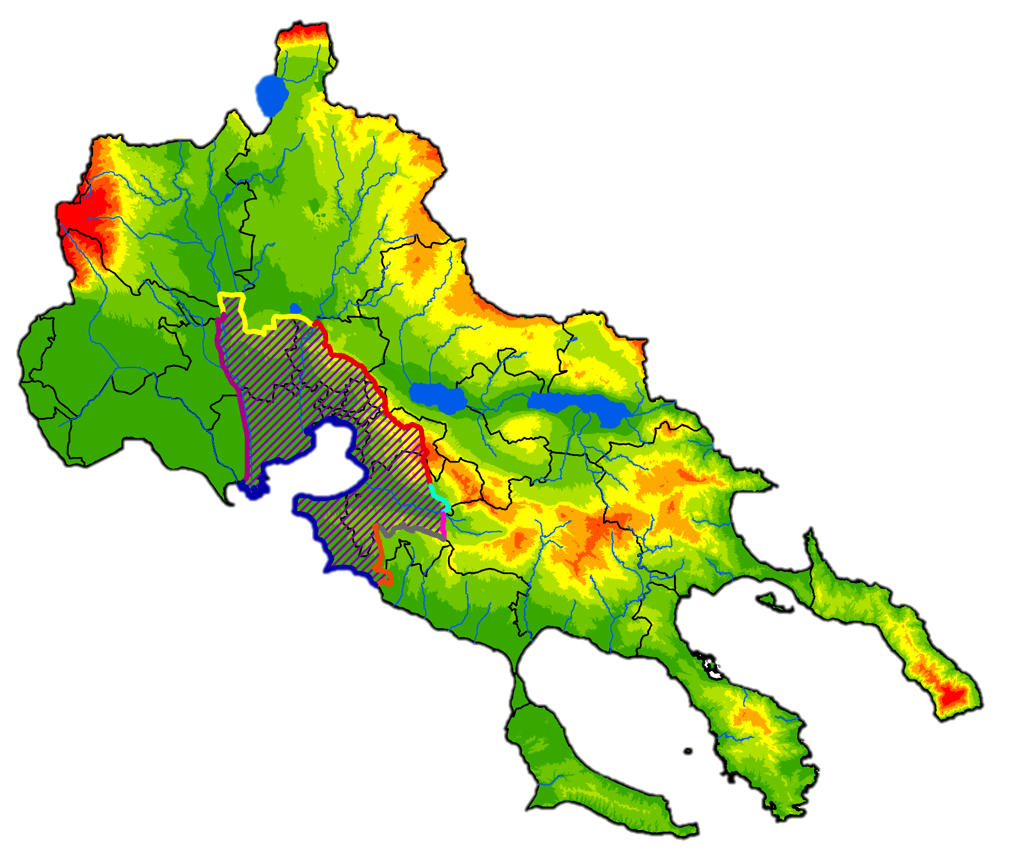
Master Plan area boundaries
Western embankment of the Axios River until the boundary of M. of Chalkidona in the area of Akropotamos River

Slide 29
Master Plan area boundaries
Boundary of M. of Chalkidona until its section with Gallikos River in the area of Filadelfeia settlement

Slide 30
Master Plan area boundaries
Drainage divide from Gallikos River until Lakkia settlement ouflowing the streams to Thermaikos Gulf

Slide 31
Master Plan area boundaries
Boundary of the plain of Vasilika until the M. of Thermi

Slide 32
Master Plan area boundaries
Boundary of the M. of Thermi until the drainage divide of Anthemountas River

Slide 33
Master Plan area boundaries
Drainage divide of Anthemountas River until Kardia settlement

Slide 34
Master Plan area boundaries
Boundary of the M. of Thermaikos until the coastline of Hrakleia settlement

Slide 35
Master Plan area boundaries
Coastline until the western embankment of the Axios River

Slide 36
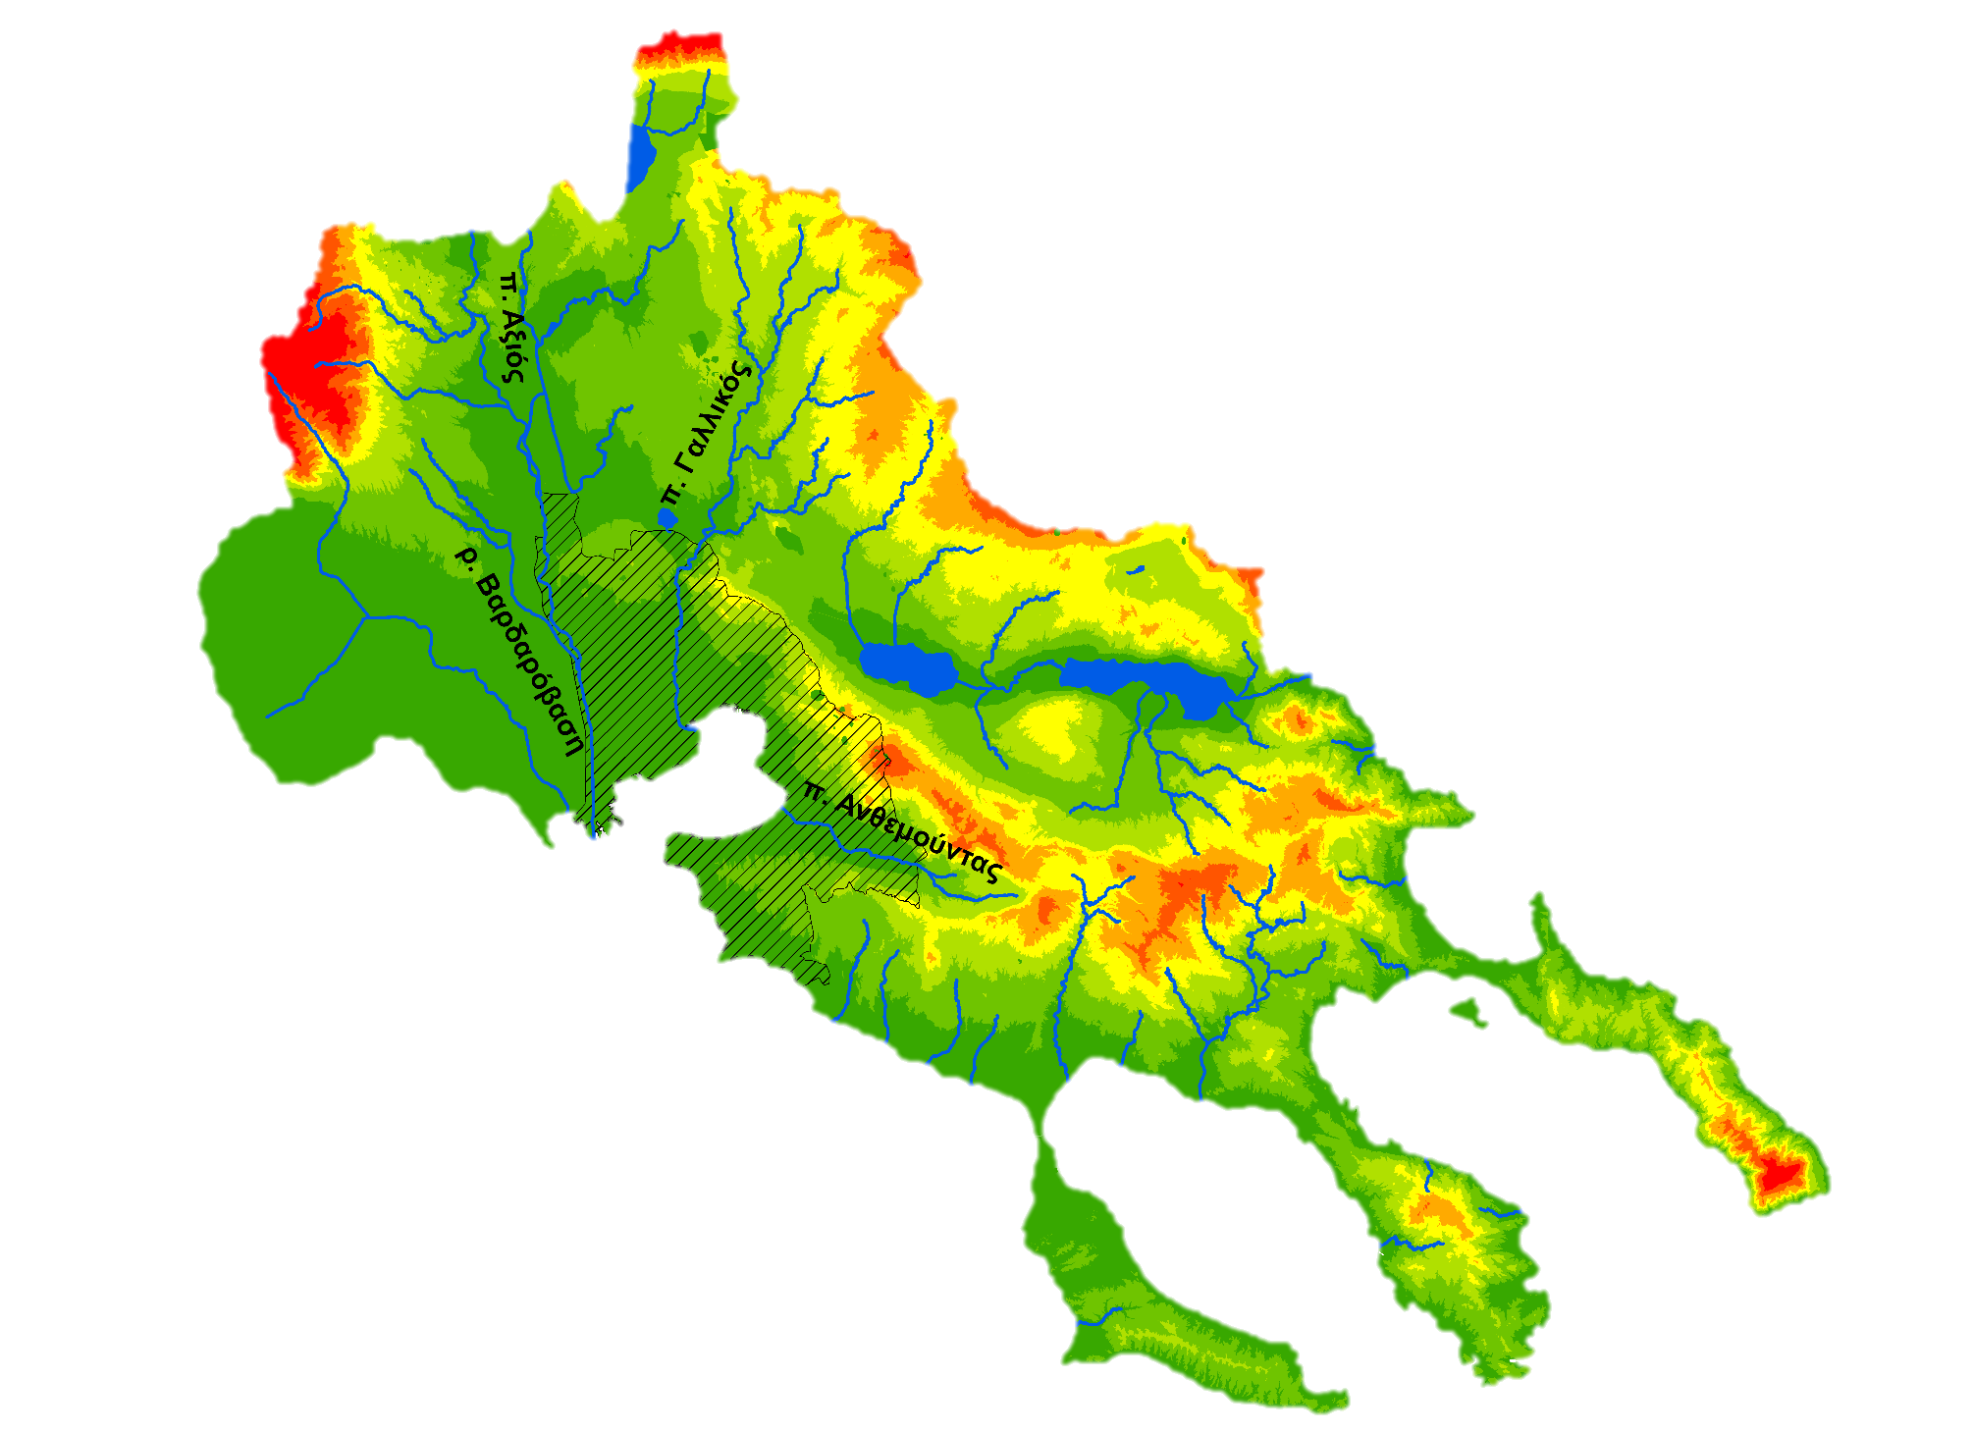
Surface Water Bodies
Main surface water bodies the Master Plan area:
Axios River
Vardarovasi River
Gallikos River
Anthemountas River

Slide 37
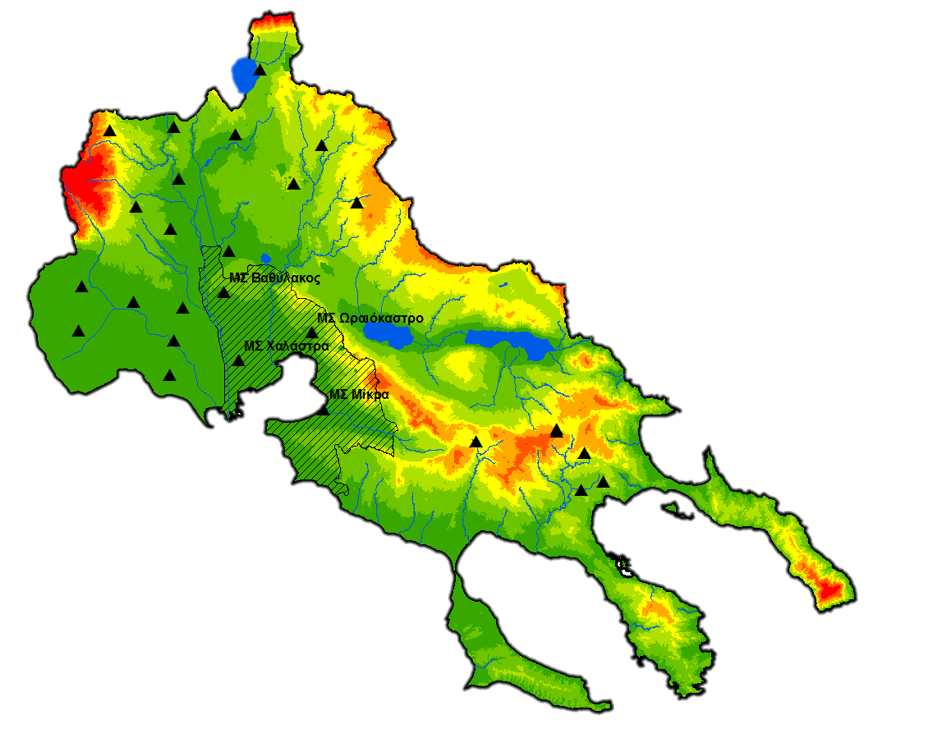
Precipitation Stations
27 Meteorological Stations (MS) are considered in the Flood Risk Management Plan of the Water District of Central Macedonia
4 MS in the study area:
MS of Chalastra
MS of Mikra
MS of Oraiokastro
MS of Vathylakos

Slide 38
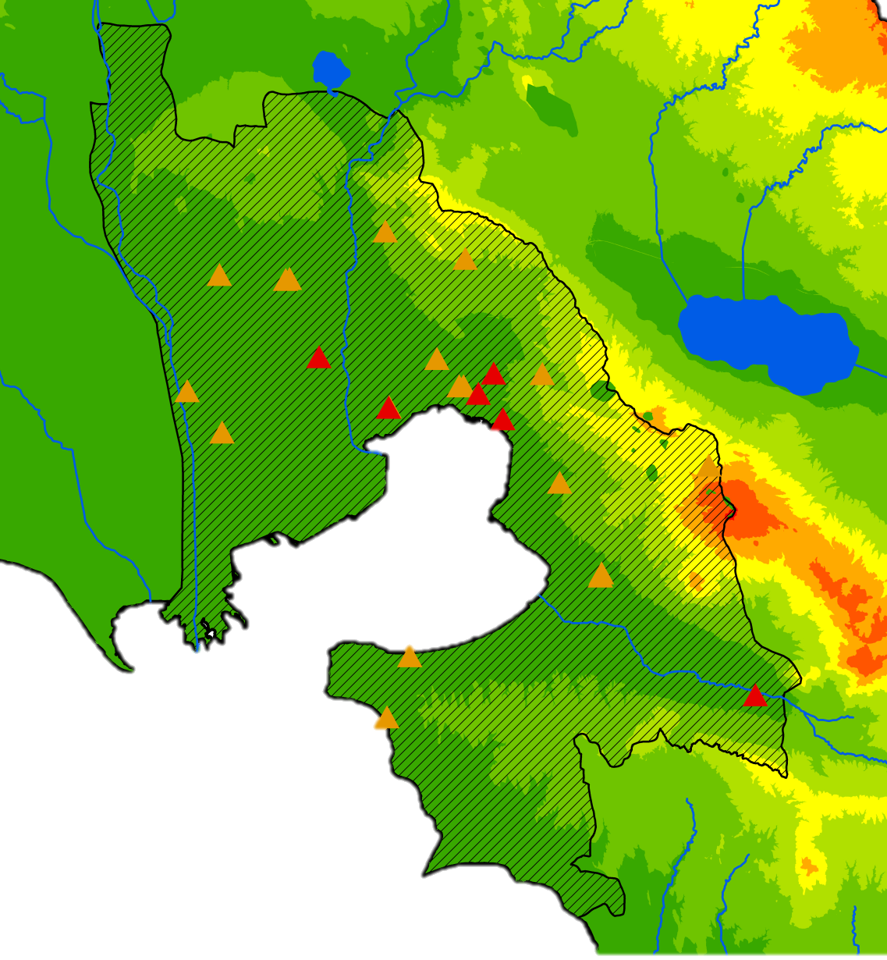
Historical Flood Events
Historical Flood Events
(43 events in the study area)
Significant historical flood events
(6 events in the study area)

Slide 39
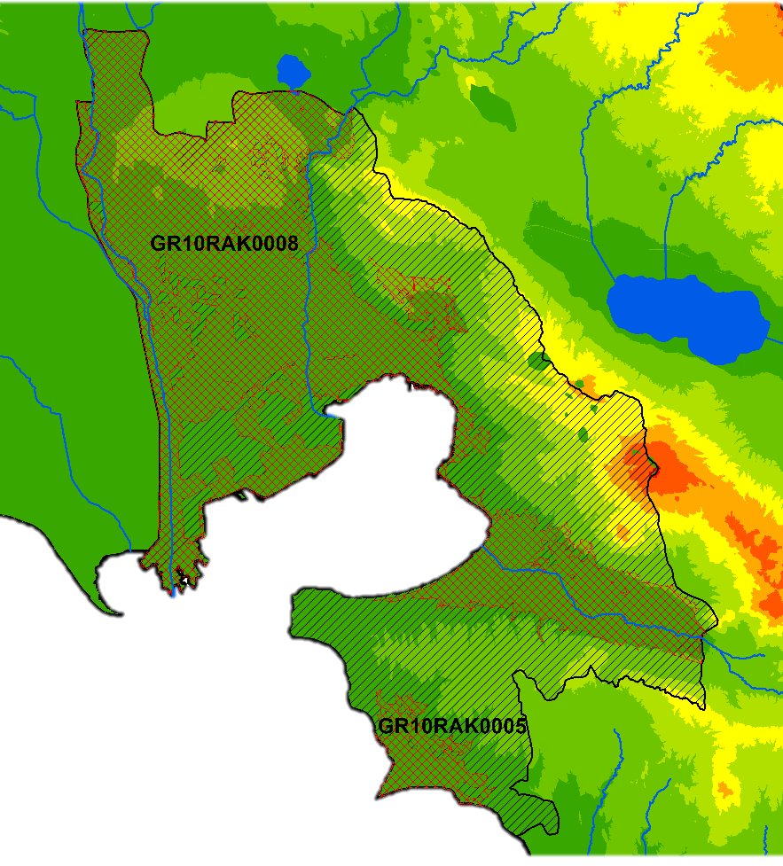
Areas of Potential Significant Flood Risk
APSFR in the study area:
GR10RAK0008
GR10RAK0005
Total area: 551.19km²
(49.93% of the Master Plan area)

Slide 40
Update of the Master Plan for Flood Protection Works in areas of the Prefecture of Thessaloniki
Main phases of the Master Plan:
Collection and organizing of the relevant information
Evaluation of the current situation
Development of proposals for the sustainable management and reduction of flood risk
Development of a data recording list and an internet web database

Slide 41
Main Phases of the Master Plan
Phase Ι – Collection and Organizing of the Relevant Information
Collection and digitization of all the available flood protection studies
Evaluation of the Flood Risk Management Plan
Localization and mapping of the existing and on-going flood protection works
Evaluation of the feasibility of the proposed works
Collection of information regarding the historical flood events in a more detailed way compared to the information included in the Flood Risk Management Plan and the 1st Revision of the River Basin Management Plan of the Water District of Central Macedonia

Slide 42
Main Phases of the Master Plan
Phase ΙΙ – Evaluation of the Current Situation
Evaluation of the effectiveness of the flood protection works
Recording of the features of the water recipients for each sub-basin
Flood risk assessment of vulnerable areas
Evaluation of the measures proposed in the Flood Risk Management Plan
Consultation with stakeholders on a frequent time basis

Slide 43
Main Phases of the Master Plan
Phase ΙΙΙ – Development of proposals for the sustainable management and reduction of flood risk
Determination of the designing principles of flood protection works
Development of structural and non-structural measures and assessment of their effectiveness
Ranking of the structural and non-structural measures under study
Development of a web-based platform for consultation with stakeholders
Development of proposals for enhancing the efficiency of the structural works
Determination of a periodic inspection and maintenance of the rivers as well the structural works

Slide 44
Main Phases of the Master Plan
Phase ΙΙΙ – Development of proposals for the sustainable management and reduction of flood risk
Development of proposals for defining the competences of the stakeholders
Development of proposals for funding the construction of new flood protection works and maintenance the existing ones

Slide 45
Main Phases of the Master Plan
Phase ΙV – Development of a Data Recording List and an Internet Web Database
Development of an information system including:
Data collected or created in the framework of the implementation of the 2007/60/EC Directive as well as the new data which will be created
Surveying of technical works within the river network, the flood protection embankments, the river channels, the main road network and the major infrastructure of the area

Slide 46
Thank you for your attention
Theme-based training of teaching staff for acquiring new teaching and learning methods
Department of Civil Engineering, Aristotle University of Thessaloniki
31th October 2019, Thessaloniki
Dr. Dimitrios Malamataris
Civil/ Hydraulic Engineer M.Sc., Ph.D.
at the Consulting Company
HYETOS S.A.
Studies, Research & Consulting Services
7 Ippodromiou Sq., 54621 Thessaloniki, Greece

Slide 47
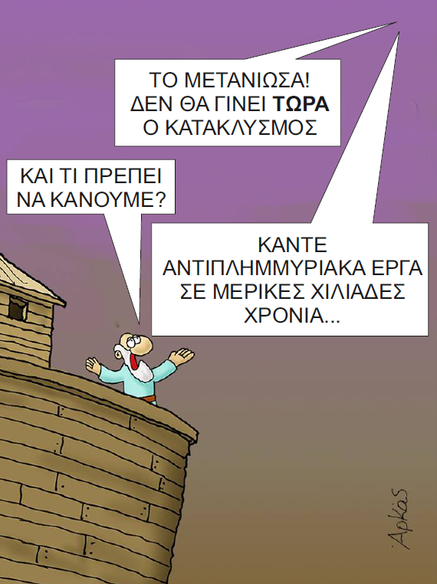
I regret it!
The deluge will not happen now
What we have to do?
Build flood protection works in several thousand years…

Slide 48
References
Dam of Pramoritsa. Last access on 30th April 2019, https://www.tovoion.com
European Organisation for the Exploitation of Meteorological Satellites. Last access on 30th April 2019, https://www.eumetsat.int/website/home/Images/ImageLibrary/DAT_3917405.html
Ilarionas artificial Lake. Last access on 30th April 2019, http://visit-msv.gr.
IPCC (2012) Managing the Risks of Extreme Events and Disasters to Advance Climate Change Adaptation. A Special Report of Working Groups I and II of the Intergovernmental Panel on Climate Change [Field, C.B., V. Barros, T.F. Stocker, D. Qin, D.J. Dokken, K.L. Ebi, M.D. Mastrandrea, K.J. Mach, G.-K. Plattner, S.K. Allen, M. Tignor, and P.M. Midgley (eds.)]. Cambridge University Press, Cambridge, UK, and New York, NY, USA, 582 pp.
IPCC (2013) Climate Change 2013: The Physical Science Basis. Contribution of Working Group I to the Fifth Assessment Report of the Intergovernmental Panel on Climate Change [Stocker, T.F., D. Qin, G.-K. Plattner, M. Tignor, S.K. Allen, J. Boschung, A. Nauels, Y. Xia, V. Bex and P.M. Midgley (eds.)]. Cambridge University Press, Cambridge, United Kingdom and New York, NY, USA, 1535 pp.
Princeton University (2005) WordNet 2.1. Princeton, New Jersey, Last access on 15th October 2019, https://wwwwordnet.princeton.edu.
World Meteorological Organization (2009) Integrated flood management: Concept paper (No. 1047). Associated Programme on Flood Management.

